Slide 1
Are you enjoying GG101?
If so, there is an opportunity to take GG200 in Fall 2014 (normally only a spring offering).
Who should take GG200?
  Students interested in GG BS or BA
  Students interested in a GG minor
  Students who enjoy learning about the Earth who still need a lower division “WI” course.

Slide 2
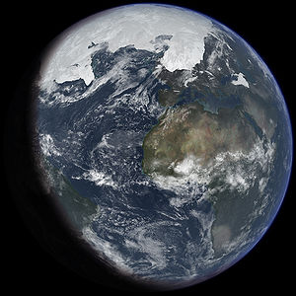
What does GG200 cover?
  About 1/3 review of GG101 at a higher level –
  Example: “What evidence informs us about the extent of ice sheets in Earth’s past?”
  About 1/3 overview of Earth’s history –
  Example: “When did land plants evolve & how did this affect the Earth system?”
  About 1/3 aimed at developing concepts that are useful in upper division GG courses.
  Example: “How does GPS data help us refine our understanding of plate tectonics?”

Slide 3

GG200: Geologic Inquiry
4 Credits
3 hours lecture: MWF 11:30 -12:20
3 hours labs: Friday 1:30-4:20
Writing Intensive course
Prerequisites: GG101 & GG101L (concurrent enrollment in the GG101 lab is OK)
Fall 2014 Instructor: Greg Ravizza
ravizza@hawaii.edu

