Slide 1
How to Write an Abstact
The purpose of an abstract:
to sell your talk or paper
The abstract must convince the reader to
keep reading or to attend your talk.

Slide 2
Parts of an Abstract:
Each should be 1-2 sentences
1. Motivation:
➔ Why do we care about this topic or problem
This section should mention:
• the importance of the work
• the challenges to further advancement
• the work’s impact if successful

Slide 3
Parts of an Abstract:
Each should be 1-2 sentences
2. Problem Statement
What problem are you trying to solve?
What is the scope of your work?
(a specific situation or general approach?)
Be careful not to use too much jargon.
The problem might come before motivation
(if the problem is obviously important)

Slide 4
Parts of an Abstract:
Each should be 1-2 sentences
3. Approach
➔ What did you do to solve the problem?
Did you develop new methods or models, or collect new data?
What is the extent of your work? (which factors did you consider and which did you ignore?)

Slide 5
Parts of an Abstract:
Each should be 1-2 sentences
4. Results
What is the answer?
Be as quantitative as possible (avoid “very”, “small”, “significant”)
Be careful not to let your numbers/results become misinterpreted (the abstract might becomes a permanent record of your work!)

Slide 6
Parts of an Abstract:
Each should be 1-2 sentences
5. Conclusions
What are the implications of your answer?
Are your results generally applicable, or only in particular cases?
What other studies are affected by your work?

Slide 7
Parts of an Abstract:
Motivation
Problem
Approach
Results
Conclusions
Big Picture
Specific to your study
Return to Big Picture

Slide 8

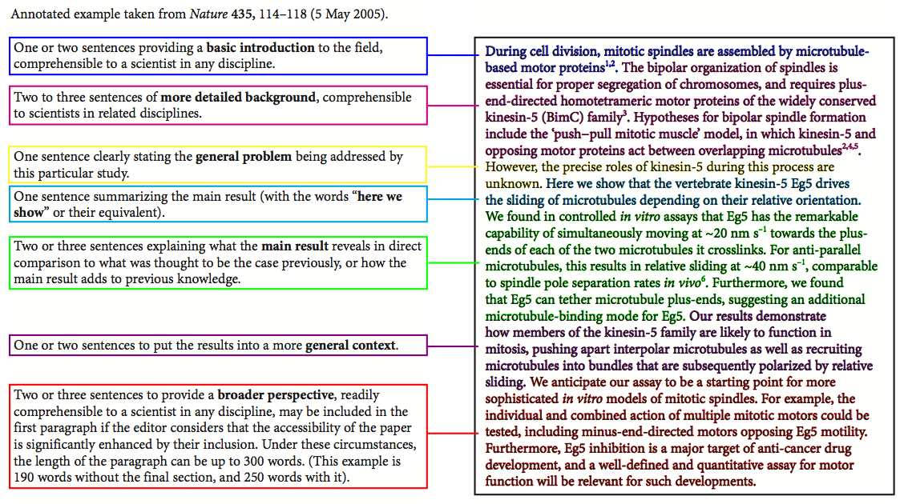

Slide 9
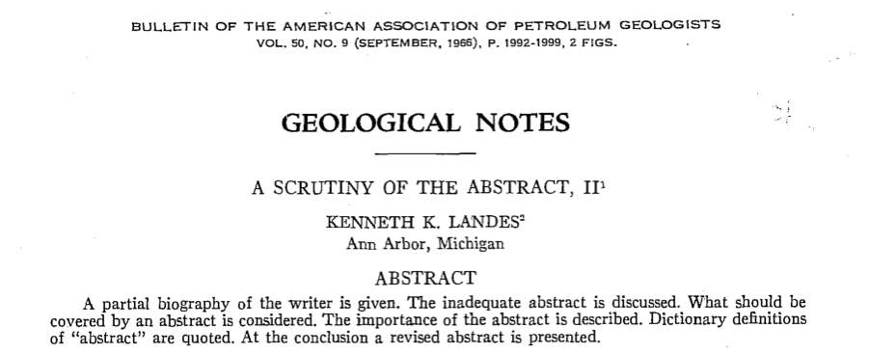
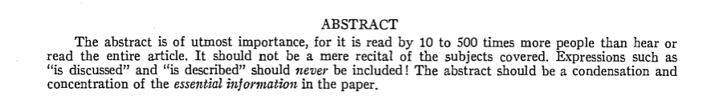

Slide 10
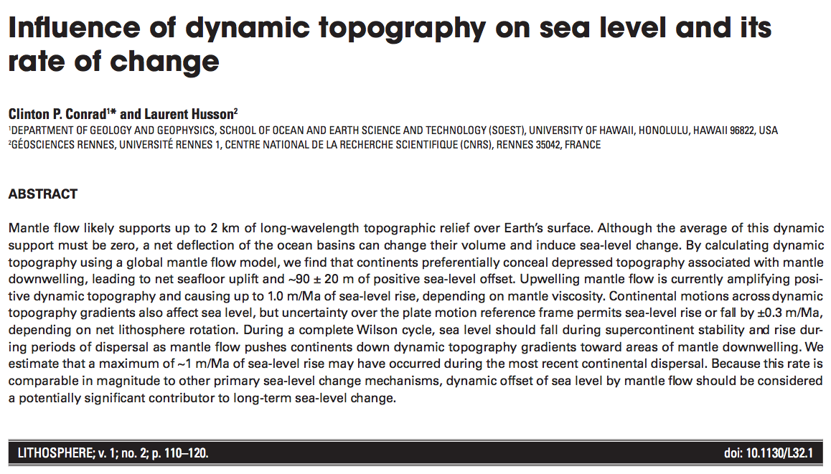

Slide 11
More to Consider
Title: Should be clear and informative, while containing all the key information
Meet the word count limitation (use all the space)
References: Use only if your work specifically addresses results from a previous paper
Never say “results of the study will be discussed”

Slide 12
Keywords / Key-phrases
Think of ~6 keywords or phrases and make sure they appear in your abstract.
Computers search on words, so you want to make sure your abstract shows up
“Keywords” are used for index searches (and to assign reviewers)

Slide 13
Assignment for Next Week
Read all four papers:
Abrupt Climate Change (by Alley)
Ocean Acidification (by Doney)
Sculpting the Earth from the Inside Out (by Gurnis)
Snowball Earth (by Hoffman & Schrag)
2. Write an abstract for one paper with your group
(200 word limit).
3. e-mail me your group abstract by Thursday Noon.
4. We will discuss the abstracts next week.

