Slide 1
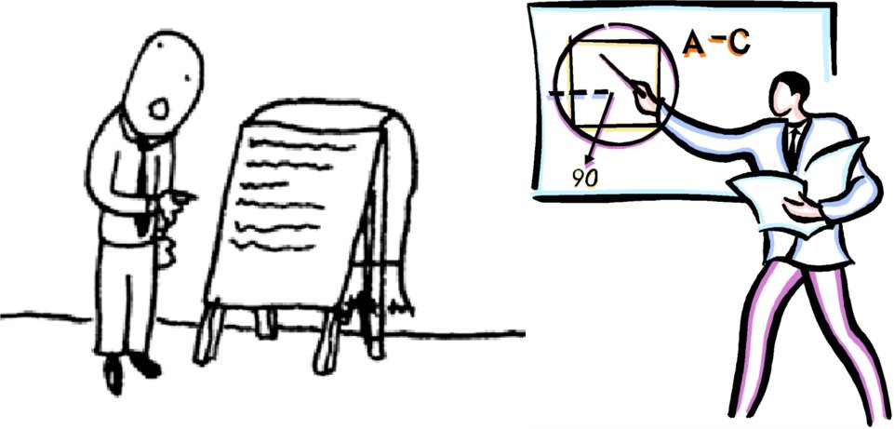
Department of Geology & Geophysics, Spring 2016
GG610: Graduate Seminar
A seminar to discuss and practice giving effective scientific presentations
Instructor:
Clint Conrad 804 POST clintc@hawaii.edu
Web Site (linked from Conrad’s web site):
http://www.soest.hawaii.edu/GG/FACULTY/conrad/classes/GG610_S16/GG610.html
(see web site for handouts, schedule, other information)

Slide 2
What is Graduate Seminar?
Practice giving scientific talks!
Exchanging feedback to help us improve our talks
Learning about each other’s research
Practice other scientific communication: Abstracts & Posters

Slide 3
What is Graduate Seminar?
Practice giving scientific talks!
Exchanging feedback to help us improve our talks
Learning about each other’s research
Practice other scientific communication: Abstracts & Posters
Why does the department require GG610?

Slide 4
What is Graduate Seminar?
Practice giving scientific talks!
Exchanging feedback to help us improve our talks
Learning about each other’s research
Practice other scientific communication: Abstracts & Posters
Why does the department require GG610?
Because giving a good talk:
→ is one of our most important tasks!

Slide 5
What is Graduate Seminar?
Practice giving scientific talks!
Exchanging feedback to help us improve our talks
Learning about each other’s research
Practice other scientific communication: Abstracts & Posters
Why does the department require GG610?
Because giving a good talk:
is one of our most important tasks!
→ is hard to do well, but can be learned

Slide 6
What is Graduate Seminar?
Practice giving scientific talks!
Exchanging feedback to help us improve our talks
Learning about each other’s research
Practice other scientific communication: Abstracts & Posters
Why does the department require GG610?
Because giving a good talk:
is one of our most important tasks!
→ is hard to do well, but can be learned
→ will increase the impact of your work

Slide 7
What is Graduate Seminar?
Practice giving scientific talks!
Exchanging feedback to help us improve our talks
Learning about each other’s research
Practice other scientific communication: Abstracts & Posters
Why does the department require GG610?
Because giving a good talk:
is one of our most important tasks!
→ is hard to do well, but can be learned
→ will increase the impact of your work
→ is ESSENTIAL for your career!

Slide 8
Preliminary Schedule:
Week Day Topic
Jan 15 Class Introduction
Jan 22 How to Give a Memorable Seminar
Jan 29 How to Write an Effective Abstract
Sept 9 Writing Abstracts
Sept 16 Poster Preparation & Presentation
Sept 23 Posters I
Feb 26 Posters II
Mar 4 Student Seminars
Mar 11 Student Seminars
Mar 18 Student Seminars
Mar 26 SPRING BREAK (no class)
11 Apr 1 Student Seminars
12 Apr 8 Student Seminars
13 Apr15 Student Seminars
14 Apr 22 Student Seminars
15 Apr 29 Student Seminars

Slide 9
Format of the class: (Starting in March)
Student Talks (two per week)
→ Talks are 12 minutes long (AGU-style)
→ Talks are followed by ~5 minutes of questions

Slide 10
Format of the class: (Starting in March)
Student Talks (two per week)
→ Talks are 12 minutes long (AGU-style)
→ Talks are followed by ~5 minutes of questions
Moderator Duties (two per week)
→ Run the show
→ Introduce the speakers
→ Make sure speakers stay on time
→ Manage questions
→ Handle lighting and a/v equipment

Slide 11
Format of the class: (Starting in March)
Student Talks (two per week)
→ Talks are 12 minutes long (AGU-style)
→ Talks are followed by ~5 minutes of questions
Moderator Duties (two per week)
→ Run the show
→ Introduce the speakers
→ Make sure speakers stay on time
→ Manage questions
→ Handle lighting and a/v equipment
Audience Duties (everyone!)
→ Attend, pay attention, and look interested
→ Ask good questions
→ Provide constructive feedback afterwards

Slide 12
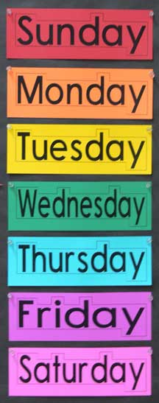
A Typical Week in GG610
by noon Initial abstract is due to instructor & group
by noon Group comments on abstract are due
by noon Final abstracts are due to instructors
afternoon Seminars are announced to deptartment
in class Seminars! Evaluations afterwards
The Following Week Feedback is communicated to speakers

Slide 13
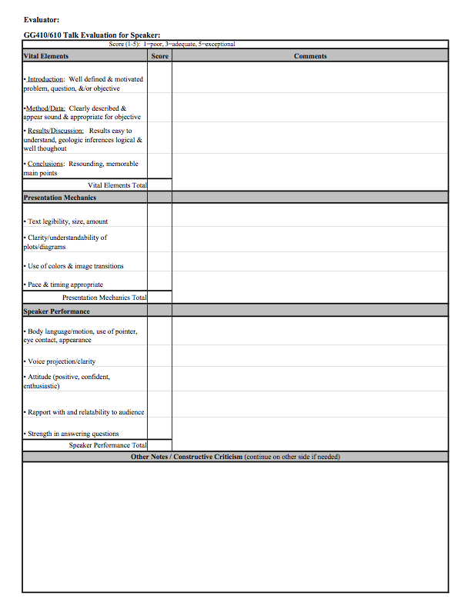
Communicating Feedback: Evaluation Forms
For each category:
Give a score:
1=poor, 3=ok, 5=great
Give a comment
Give general comments
at the end

Slide 14
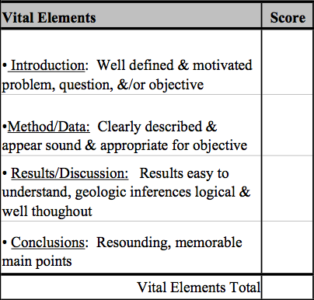
Communicating Feedback: Evaluation Forms

Slide 15
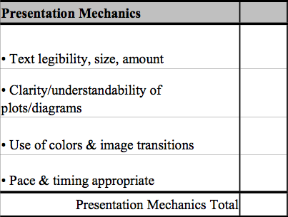
Communicating Feedback: Evaluation Forms

Slide 16
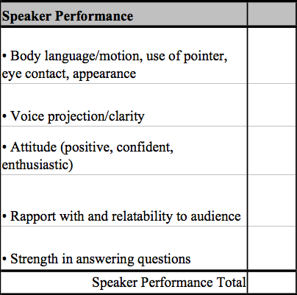
Communicating Feedback: Evaluation Forms

Slide 17
Grading
Seminars 40%
Abstracts / Posters 30%
Evaluations 10%
Class Attendance 10%
Class Participation 10%
Total 100%
Your Presentations
Audience Duties

Slide 18
Grading
Seminars 40%
Abstracts 30%
Evaluations 10%
Class Attendance 10%
Class Participation 10%
Total 100%
Your Presentations
Audience Duties
Other Assignments
1. Out-of-Class Evaluations: Evaluate 3 additional talks
using the evaluation form
2. Write abstracts for assigned papers (week 4).
3. Mini-Presentation (Weeks 6 & 7).

Slide 19
Preliminary Schedule:
Week Day Topic
Jan 15 Class Introduction
Jan 22 How to Give a Memorable Seminar
Jan 29 How to Write an Effective Abstract
Sept 9 Writing Abstracts
Sept 16 Poster Preparation & Presentation
Sept 23 Posters I
Feb 26 Posters II
Mar 4 Student Seminars
Mar 11 Student Seminars
Mar 18 Student Seminars
Mar 26 SPRING BREAK (no class)
11 Apr 1 Student Seminars
12 Apr 8 Student Seminars
13 Apr15 Student Seminars
14 Apr 22 Student Seminars
15 Apr 29 Student Seminars

Slide 20
Comments from previous semesters
On the first half of the semester:
“Instead of wasting half of the semester on presentation
techniques … students should present twice”

Slide 21
Comments from previous semesters
On the first half of the semester:
“Instead of wasting half of the semester on presentation
techniques … students should present twice”
“Abstract & poster classes were helpful, as was the mini-presentation”
“More how-to’s (i.e., talks, abstracts, posters, etc.) This stuff is useful”

Slide 22
Comments from previous semesters
On the first half of the semester:
“Instead of wasting half of the semester on presentation
techniques … students should present twice”
“Abstract & poster classes were helpful, as was the mini-presentation”
“More how-to’s (i.e., talks, abstracts, posters, etc.) This stuff is useful”
On the seminar format:
“It’s a supportive environment to get feedback and practice”
“I would make the presentations longer (10-20 min)”
“Often frustrating when people are giving 5’s across the
board … there is always room for improvement”

Slide 23
Comments from previous semesters
On the first half of the semester:
“Instead of wasting half of the semester on presentation
techniques … students should present twice”
“Abstract & poster classes were helpful, as was the mini-presentation”
“More how-to’s (i.e., talks, abstracts, posters, etc.) This stuff is useful”
On the seminar format:
“It’s a supportive environment to get feedback and practice”
“I would make the presentations longer (10-20 min)”
“Often frustrating when people are giving 5’s across the
board … there is always room for improvement”
On 610 itself:
“Let us test out of it!”

Slide 24
Comments from previous semesters
On the first half of the semester:
“Instead of wasting half of the semester on presentation
techniques … students should present twice”
“Abstract & poster classes were helpful, as was the mini-presentation”
“More how-to’s (i.e., talks, abstracts, posters, etc.) This stuff is useful”
On the seminar format:
“It’s a supportive environment to get feedback and practice”
“I would make the presentations longer (10-20 min)”
“Often frustrating when people are giving 5’s across the
board … there is always room for improvement”
On 610 itself:
“Let us test out of it!”
“This course makes me a better speaker!”

Slide 25
“This course makes me a better speaker!”
HOW?

Slide 26
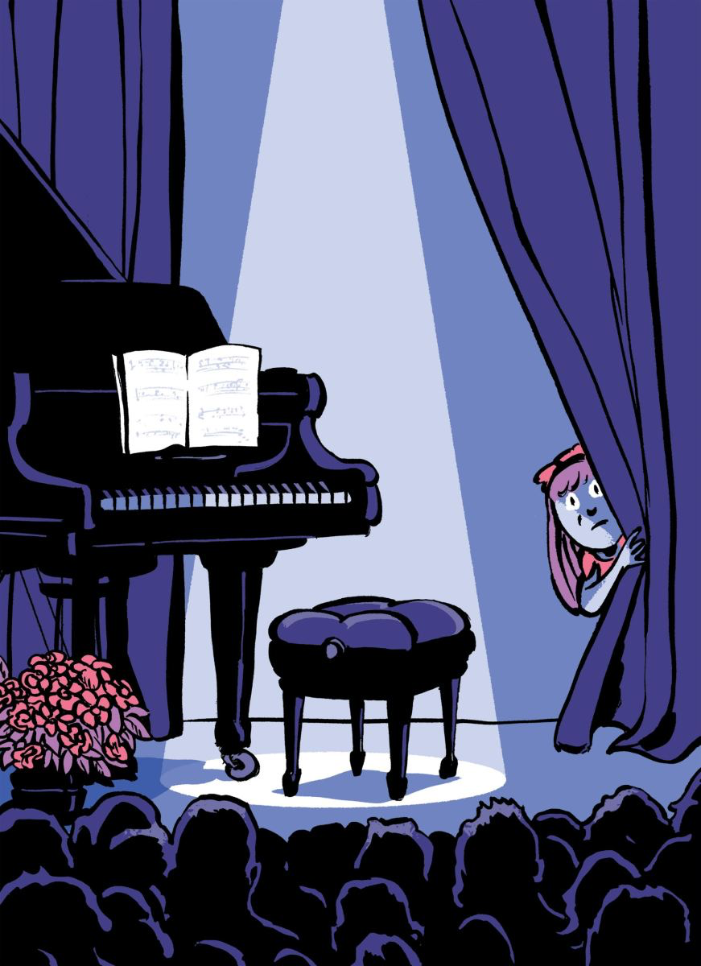
Next Week: How to Give a Memorable Seminar
Assigned Reading (on the class website):
I Can’t Go On!
What’s behind stagefright?
By Joan Acocella
A review of:
“Playing Scared: A History and
Memoir of Stage Fright”
The New Yorker, Aug. 3, 2015

Slide 27
Next Week: How to Give a Memorable Seminar
Assigned Reading (on the class website):
I Can’t Go On!
What’s behind stagefright?
By Joan Acocella
A review of:
“Playing Scared: A History and
Memoir of Stage Fright”
The New Yorker, Aug. 3, 2015
Questions to consider: 1. Do scientists get stagefright?
2. How is a scientific presentation
similar to an artistic performance? How is it different?

