Slide 1
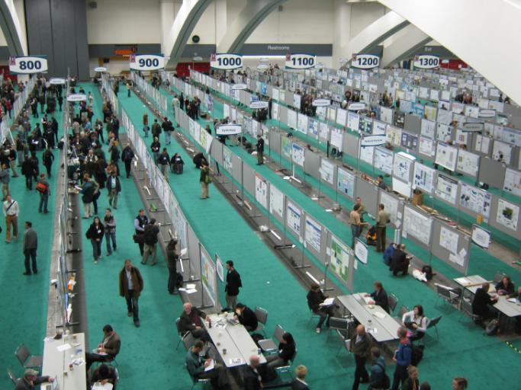
How to Present an Effective Poster

Slide 2
How to Present an Effective Poster
Consider your message
A poster is:
A source of information
A topic for a scientific conversation
An advertisement for your work
A summary of your work

Slide 3
How to Present an Effective Poster
Consider your message
A poster is:
A source of information
A topic for a scientific conversation
An advertisement for your work
A summary of your work
Like a talk, a poster should make one main point,
but you can include a few more details…

Slide 4
How to Present an Effective Poster
Consider your message
A poster is:
A source of information
A topic for a scientific conversation
An advertisement for your work
A summary of your work
Like a talk, a poster should make one main point,
but you can include a few more details…
Think about:
What should your poster-viewers take home?
If you help them for 3-5 minutes, will they
understand this easily?

Slide 5
How to Present an Effective Poster
2. Like a talk, tell a story:
Beginning: What problem are you trying to solve?
How do you plan to solve this problem?

Slide 6
How to Present an Effective Poster
2. Like a talk, tell a story:
Beginning: What problem are you trying to solve?
How do you plan to solve this problem?
Middle: Describe your method.
Show your results / discoveries.
Make sure everything is relevant and
easily digested.

Slide 7
How to Present an Effective Poster
2. Like a talk, tell a story:
Beginning: What problem are you trying to solve?
How do you plan to solve this problem?
Middle: Describe your method.
Show your results / discoveries.
Make sure everything is relevant and
easily digested.
End: What are the implications of your work?
Highlight a few main conclusions.

Slide 8
How to Present an Effective Poster
2. Like a talk, tell a story:
Beginning: What problem are you trying to solve?
How do you plan to solve this problem?
Middle: Describe your method.
Show your results / discoveries.
Make sure everything is relevant and
easily digested.
End: What are the implications of your work?
Highlight a few main conclusions.
3. Organize your Poster (next page)

Slide 9
4. Results
Title: in Big Bold Letters
Author1, Author2
Affiliation1, Affiliation2
Results
Figure
Text that discusses main results here.
1. Introduction
3. Methods
Results
Figure
Intro
Figure
Methods
Figure
Introductory
text here
5. Conclusions
Discuss methods
here
Conclusion1
Conclusion2
Conclusion3
Illustration
showing
what we
learned
2. Setup
(or technical aspect)
text
Methods
Figure
[Citation for my paper on this topic]
Figure
References available upon request

Slide 10
Horizontal Poster

Slide 11
Vertical
Poster

Slide 12
How to Present an Effective Poster
4. Use graphics to tell your story.
• Cut your text: people won’t read it anyway
• Graphics present information more effectively
than text (at least when viewed quickly)
• Remember: you will be there to explain the context.
• Attractive graphics will draw people to your poster.

Slide 13
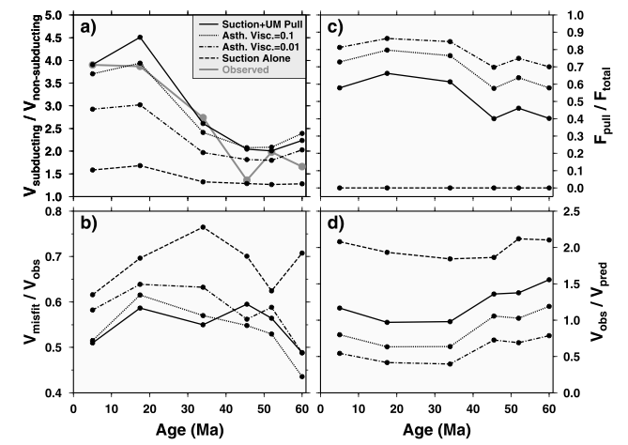
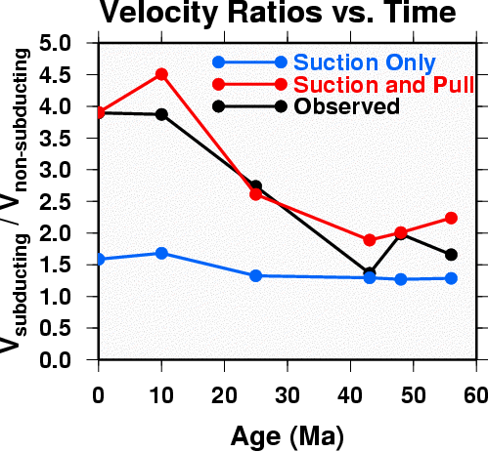
How to Present an Effective Poster
5. Figures should be clear to the point!
Axes and labels should be easy to read.
From a paper:
For a poster:

Slide 14
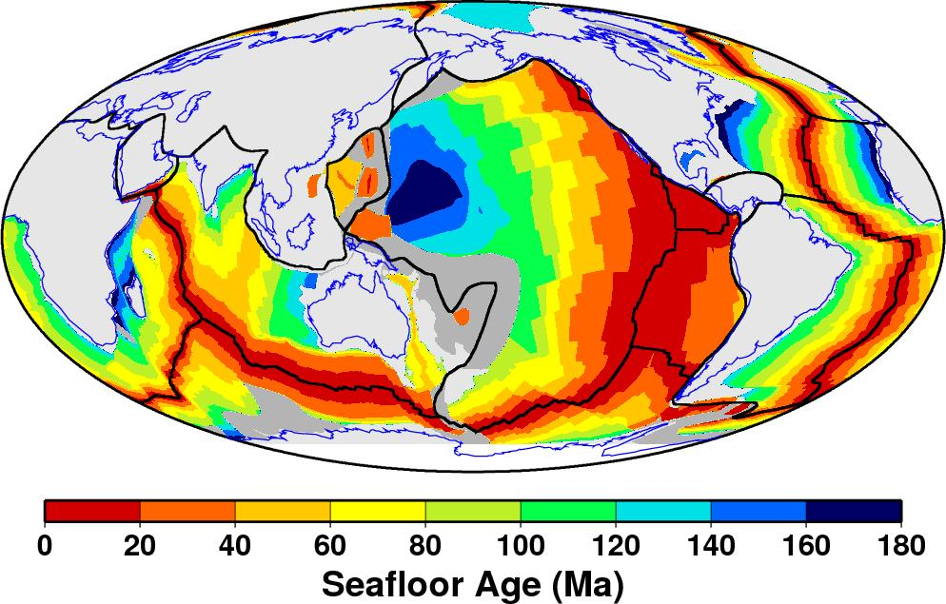
How to Present an Effective Poster
6. Be careful with equations
Do include if useful for discussions with experts
Do NOT include more than 1-2 equations
Make them as simple as possible.
From a paper:
For a poster:

Slide 15
How to Present an Effective Poster
7. Use text wisely
• Make text is large enough to read:
Title should be readable at 15-20 feet
Your name should be obvious
All text should readable at 6 feet
• Citations: Use sparingly, and make them short
• Some “experts” say that text should be ~20%
(~45% graphics and ~35% empty space)
• Use the same font throughout
• Use a bare minimum of text!

Slide 16
How to Present an Effective Poster
8. Use color wisely
• Don’t let the colors distract the viewer:
Avoid bright- or many-colored backgrounds
Pale backgrounds are least distracting
• Use black text on pale background or light text
(white or yellow) on a dark background
• Use colors to help organize the poster

Slide 17
How to Present an Effective Poster
9. Presentation tips
Audience:
Tell colleagues about your poster in advance
Bring friends to your poster first – practice your
presentation on them.

Slide 18
How to Present an Effective Poster
9. Presentation tips
Audience:
Tell colleagues about your poster in advance
Bring friends to your poster first – practice your
presentation on them.
Presentation: Just a few minutes!
Gauge a listener’s background and interest
– tailor your presentation to suit
Be positive and enthusiastic.

Slide 19
How to Present an Effective Poster
9. Presentation tips
Audience:
Tell colleagues about your poster in advance
Bring friends to your poster first – practice your
presentation on them.
Presentation: Just a few minutes!
Gauge a listener’s background and interest
– tailor your presentation to suit
Be positive and enthusiastic.
Interaction:
Try not to ignore potentially interested people
Follow up with interested people after the poster
Don’t stray too far away from your poster!

Slide 20
How to Present an Effective Poster
10. Distinguish your poster
• Use video or other “props” if appropriate.
• Include small “poster-to-go” hard copy for people
to take with them (?)
• If you can choose your location: arrive early
and pick a prominent location

Slide 21


Slide 22
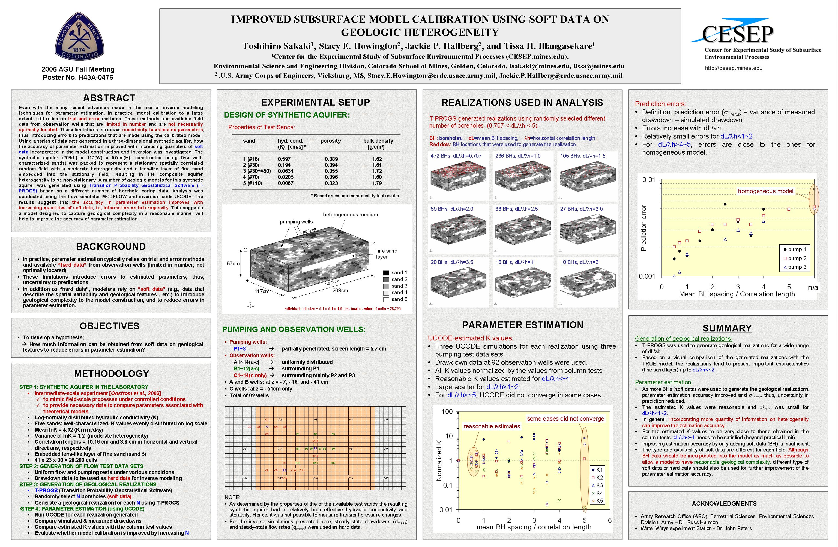

Slide 23


Slide 24
Next 2 weeks: mini – presentations
Everyone will present 2-3 slides or a poster.
Present your project very compactly (3-5 min or less)
Use this presentation “advertise” your work.
Send your slides/poster to me by Thursday
Tips:
Must be VERY concise! (but remember your audience)
Introduction: Present your problem
Method: State how your solved the problem.
Results: Present your main discovery.
Conclusion: Tell why this is important.

Slide 25
Schedule of presentations:
Feb 19
1. Joe Fackrell
2. Kendra Lynn
3. Nicole Robinson
4. Erin Fitch
5. Melissa Adams
6. David Frank
Feb. 26
1. Andrea Gabrieli
2. Estelle Bonny
3. Bianca Mintz
4. Brytne Okuhata
5. Yi Hu
6. Julie Schnurr
7 Xiaojing Lai
8. Christina Richardson

Slide 27

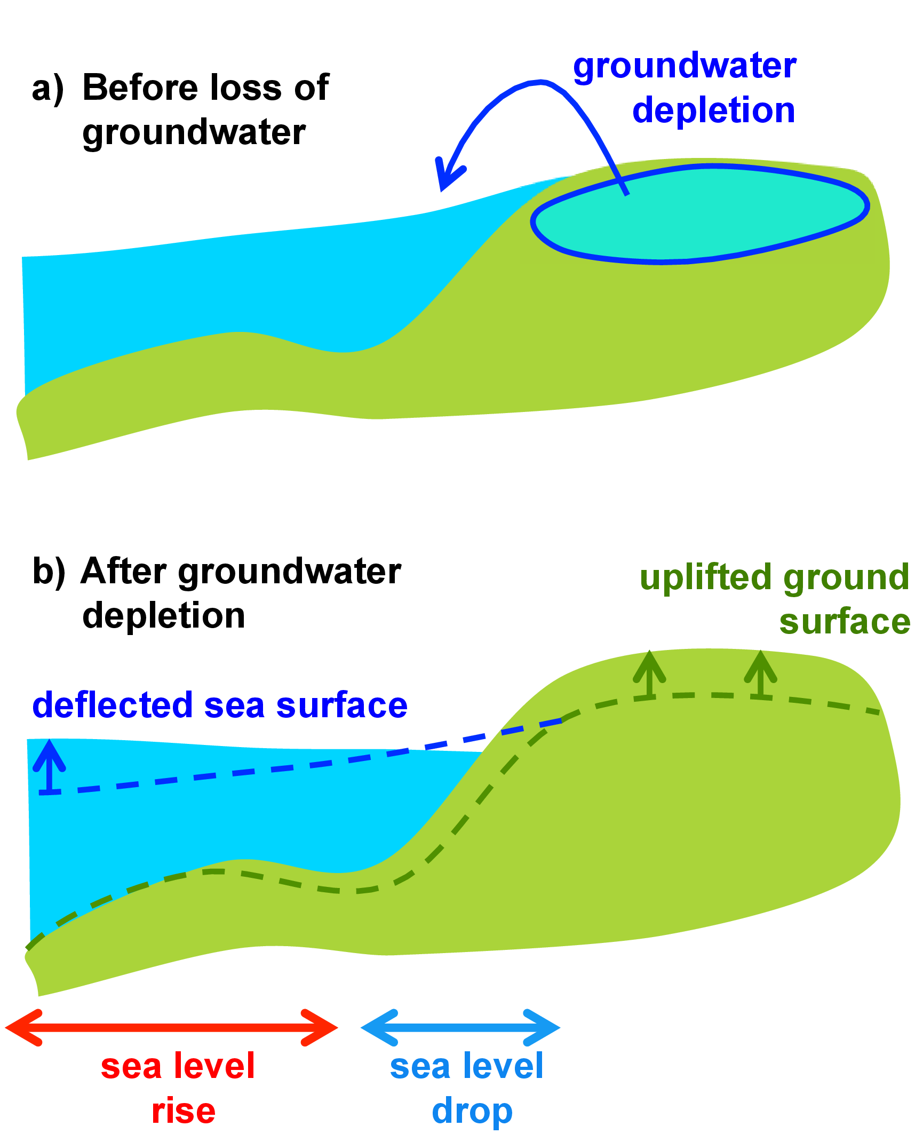
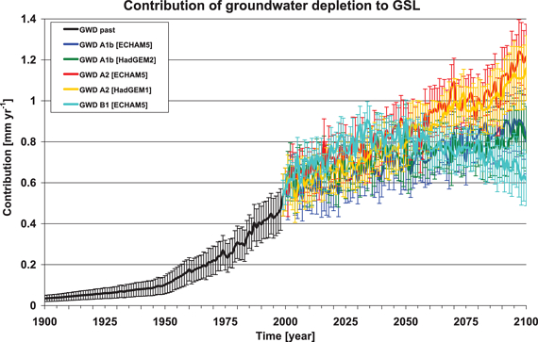
The Impact of Groundwater Depletion on
Spatial Variations in Sea Level Change During the Past Century
Emeline Veit Dept. Geology & Geophysics
Clinton P. Conrad* Univesity of Hawaii
Svetlana I. Natarov Honolulu, HI 96822, USA
Rate of sea level rise due to ground-water depletion [Wada et al., 2010]
Can we detect groundwater depletion in the sea level rise record?

Slide 28
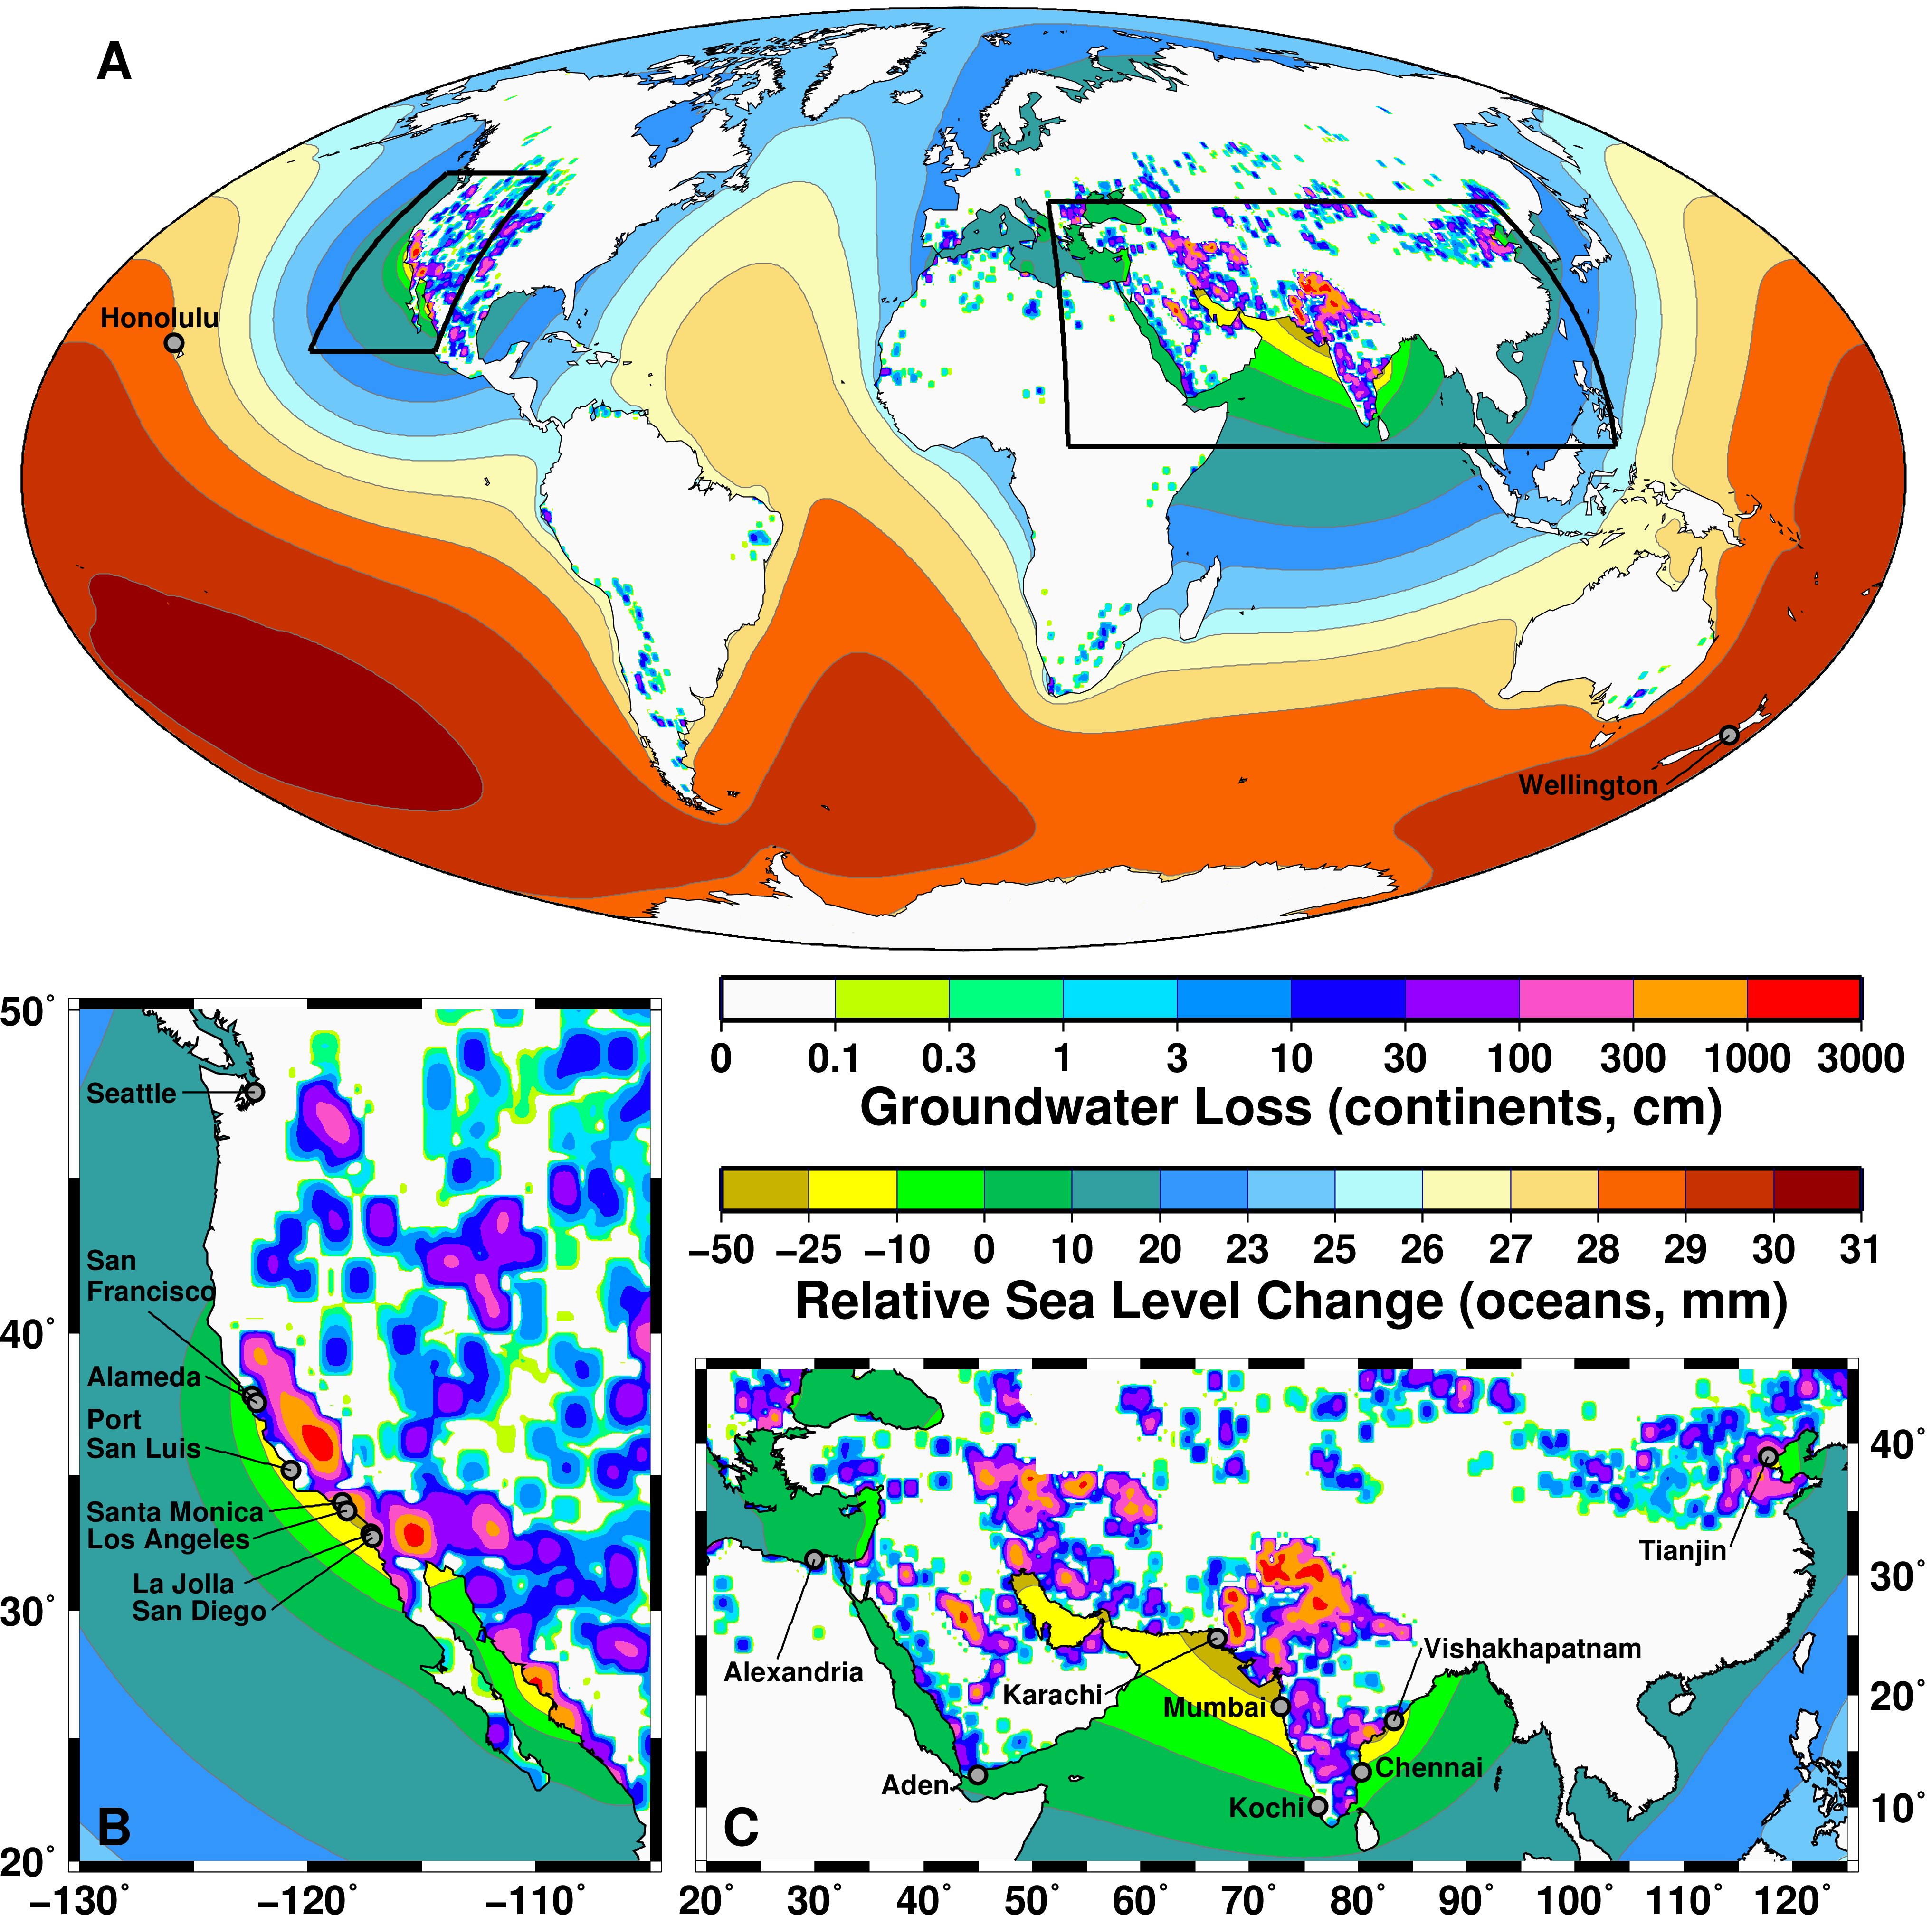
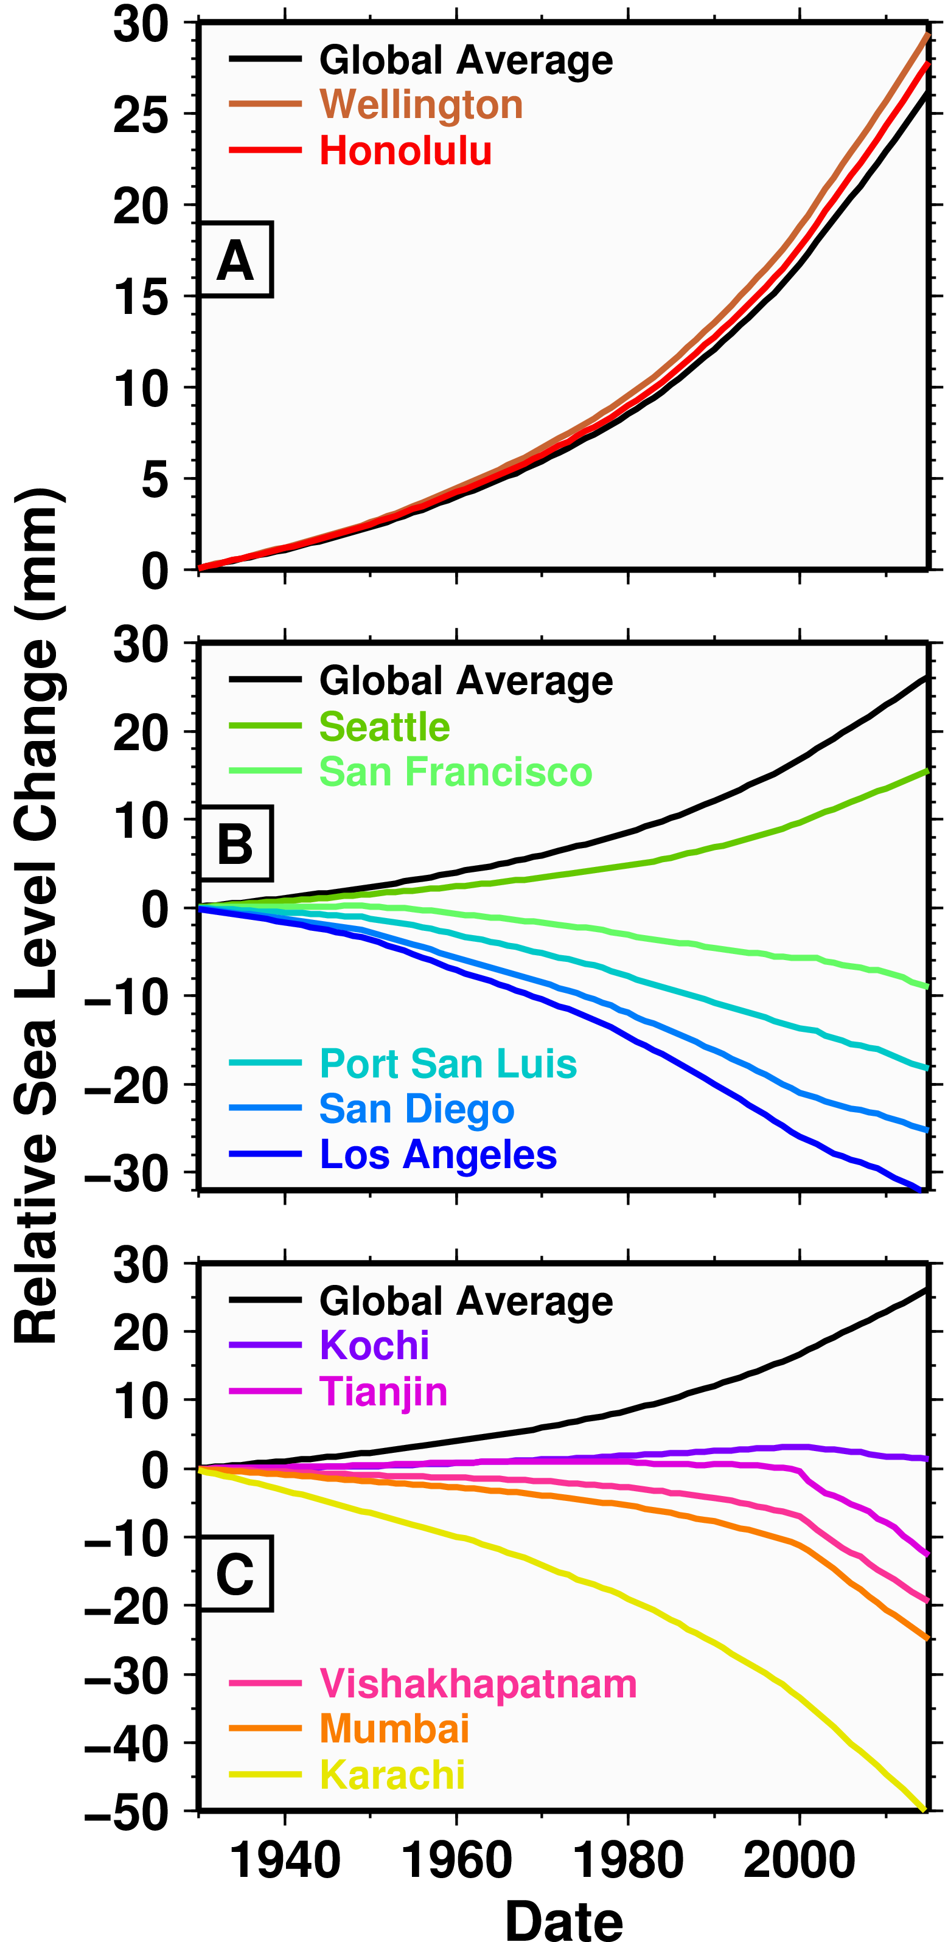
Model predictions of sea level change due to groundwater depeletion
Relative Sea Level Change (mm)

Slide 29
Regional Averages of Tide Gauges (Sea level change since 1930)
Compare to global mean sea level change: 1.8 mm/yr
[Church & White, 2011]
Conclusions
Groundwater depletion causes deflections of sea level and the solid earth.
Groundwater extraction in western North America and southern Asia has slowed sea level rise in these regions by ~0.3-0.5 mm/yr since 1930.
Groundwater depletion is important for understanding patterns of sea level change (both past and future).
Veit & Conrad [GRL, submitted, 2016]

