Slide 1
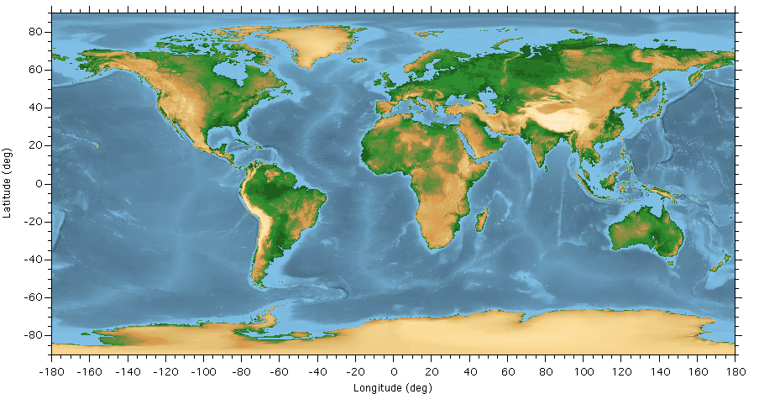
Dr. Clint Conrad
POST 804
clintc@hawaii.edu
GG 612 Big Gulp
Spring 2012
Gravity, the Geoid, and
Mantle Dynamics

Slide 2
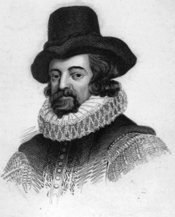
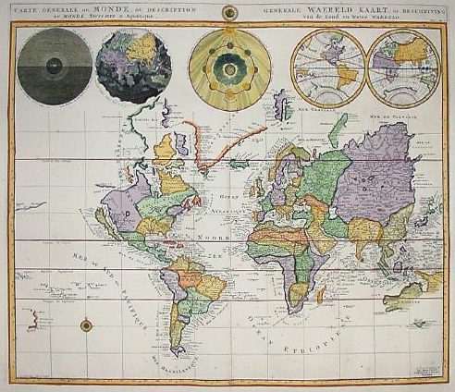
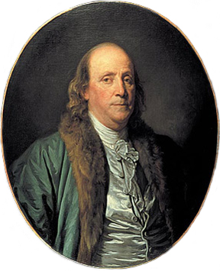
Francis Bacon (1561-1626)
The Known World, ~1700
Was the Atlantic once closed?
If so, how could this be?
Ben Franklin (1706-1790)

Slide 3
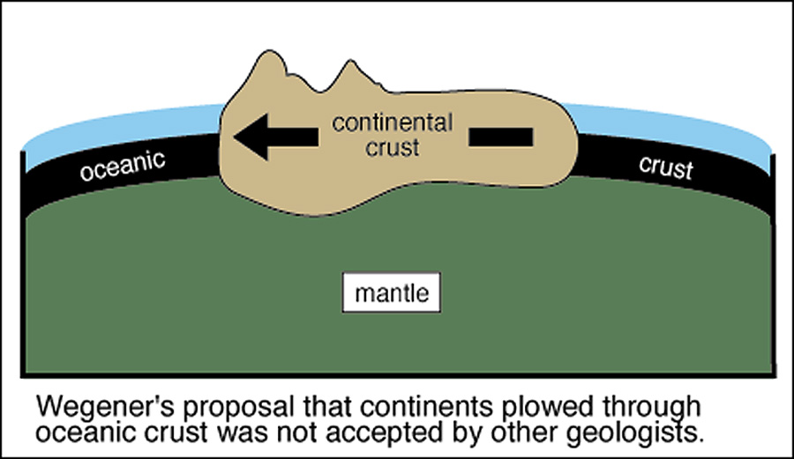

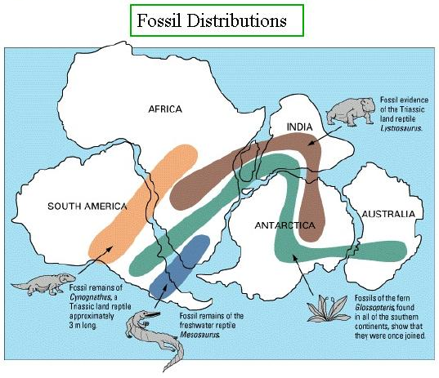
Alfred Wegener (1880-1930)
The two sides of the Atlantic:
Matching Shapes
Matching Rock Types
Matching Fossils
Patterns of Uplift

Slide 4
Wegener's Idea: The Origin of Continents and Oceans (1915)
Continental Drift:
The Continents plowed through the oceanic crust
Problem:
Wegener did not describe the forces that caused
continents to move!

Slide 5
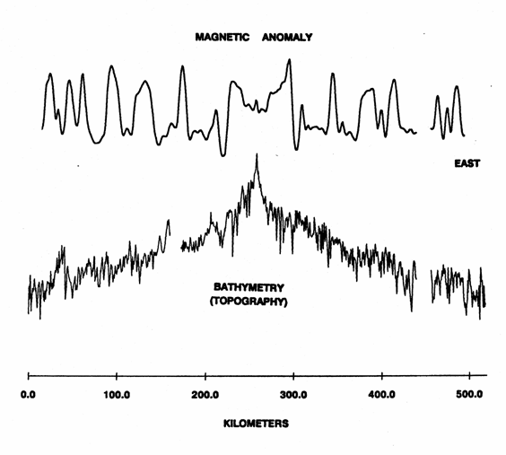
1950s - Magnetic Surveys of the Seafloor
Magnetic Anomaly:
symmetric about ridge
Seafloor Bathymetry:
descends away from ridge

Slide 6
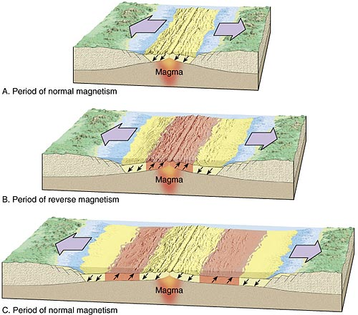
A new idea: Seafloor Spreading
New seafloor is being
created as the seafloor
spreads
The magnetic field
is "frozen" in the
newly-created seafloor.

Slide 7
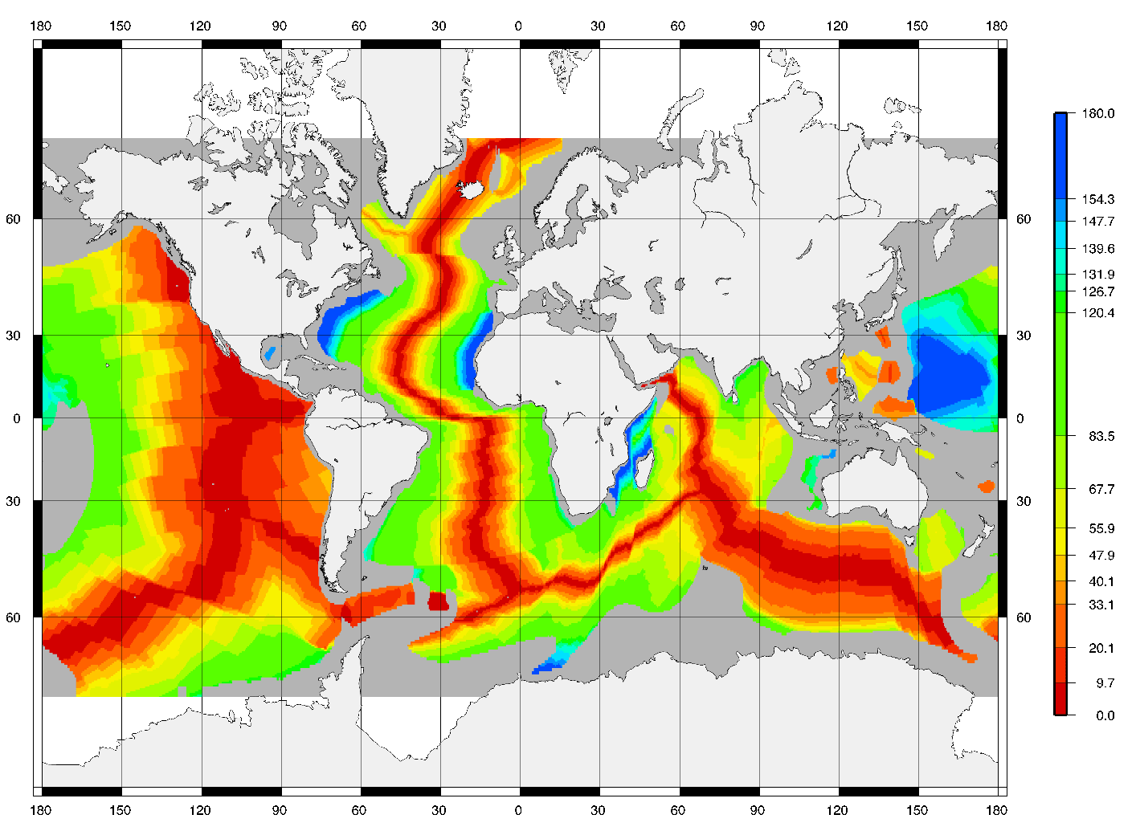
Mapping Seafloor Ages
Oldest Seafloor = 180 Million Years!

Slide 8
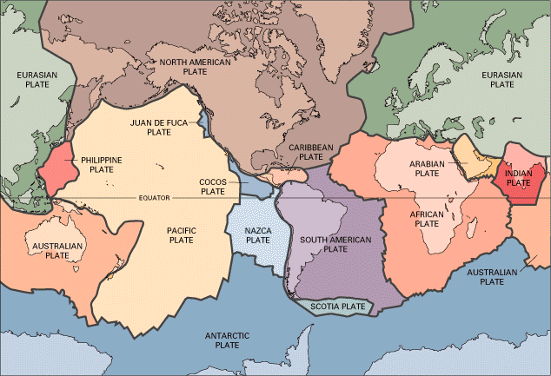
Earth's Tectonic Plates
Biggest Plate: Pacific Plate (10,000 km across)
Smallest Plate: Juan de Fuca (300 km across)
All sizes in between!

Slide 9
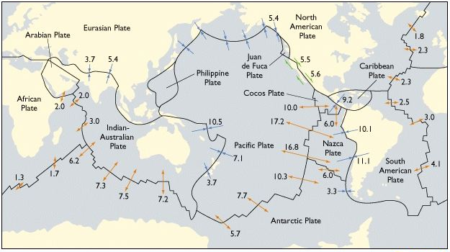
What Happens at the Boundaries of Plates?

Slide 10
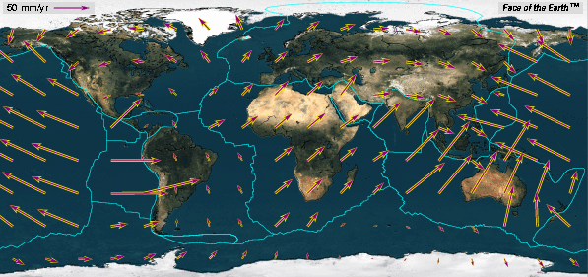
How Fast do the Plates Move?
Plate Speeds
Atlantic Basin: 1-2 cm/yr
Indian Basin: 3-7 cm/yr
Pacific Basin: 5-10 cm/yr

Slide 11

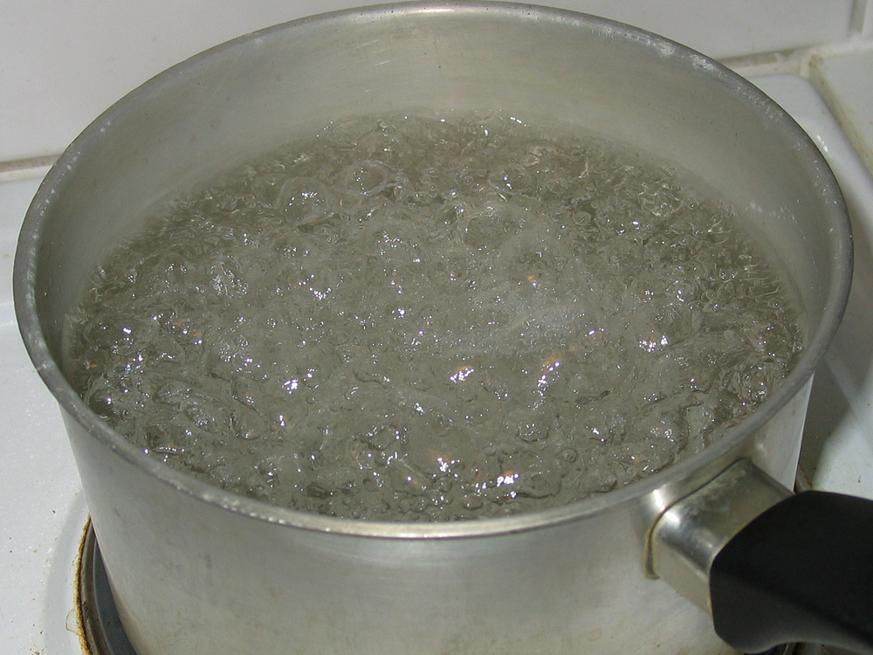
What drives the plate motions?
WHY do the plates move?
The Earth loses heat through CONVECTION
Examples of Convection
Lava lamp
Boiling water

Slide 12


Convection in Miso Soup

Slide 13
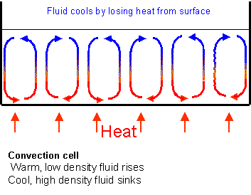
How Convection Works
Cold Fluid Sinks
Hot Fluid Rises
Convection is the
fastest way for the
Earth to get rid of heat

Slide 14
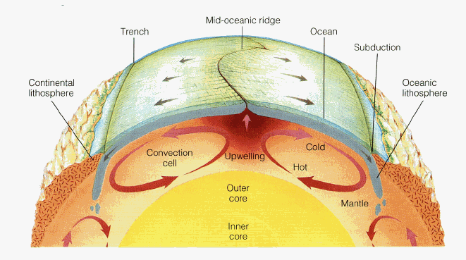
Mantle Convection and Plate Tectonics
UPWELLING beneath spreading ridges
DOWNWELLING beneath subduction zones
THE PLATES surface expression of
mantle convection

Slide 15
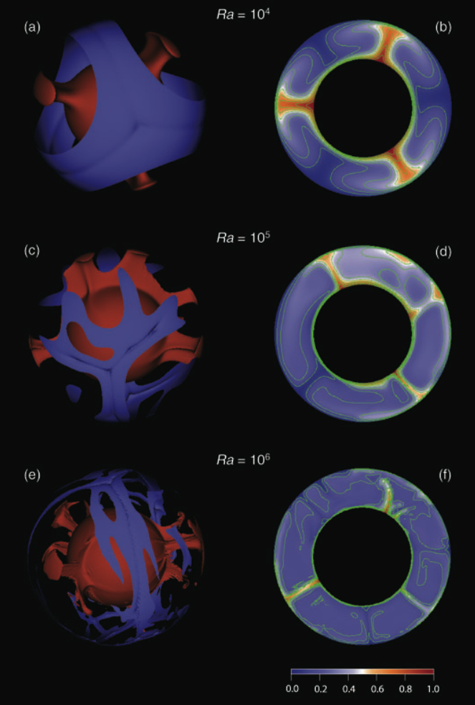
Mantle Convection:
How Vigorous?
Deschamps et al., 2010
The Rayleigh Number
(Ra) measures the vigor
of convection

Slide 16
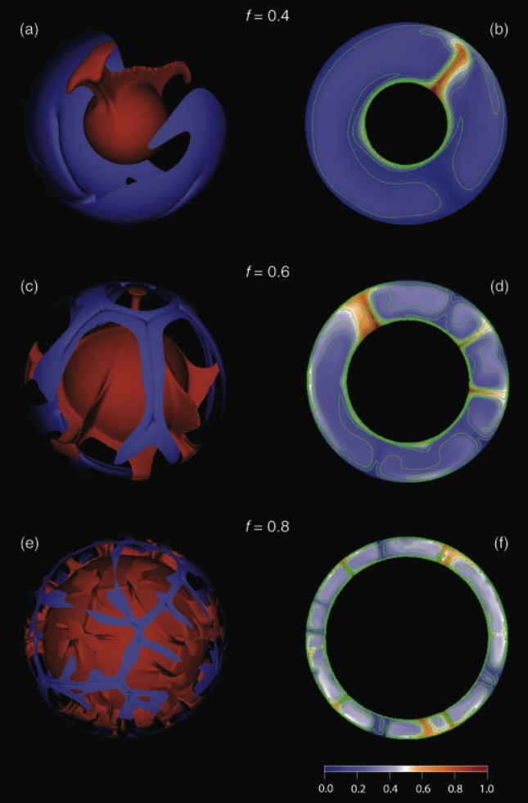
Mantle Convection:
Effect of Core Size
Ra =10⁵
Deschamps et al., 2010
Convection cells form
with an aspect ratio
greater than 1

Slide 17
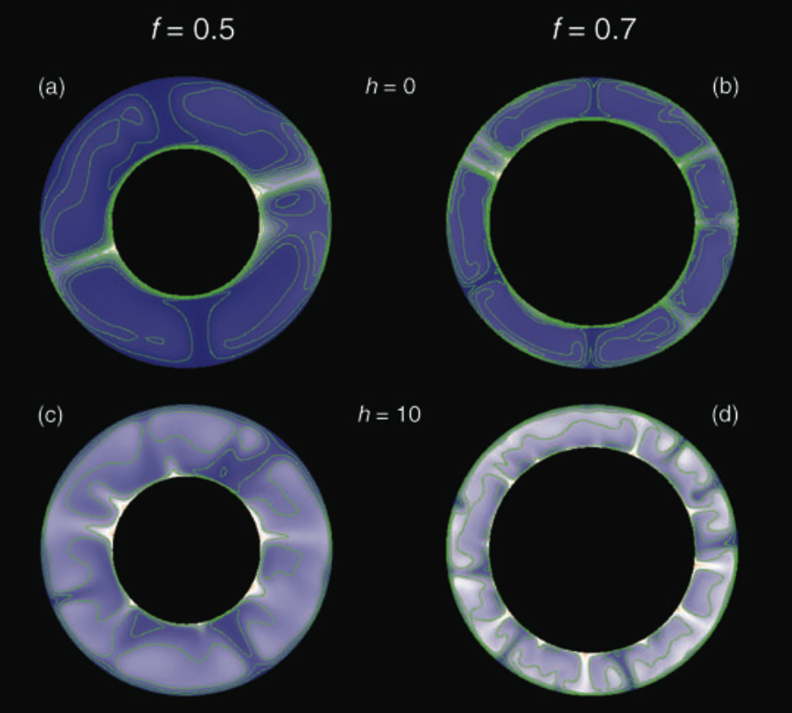
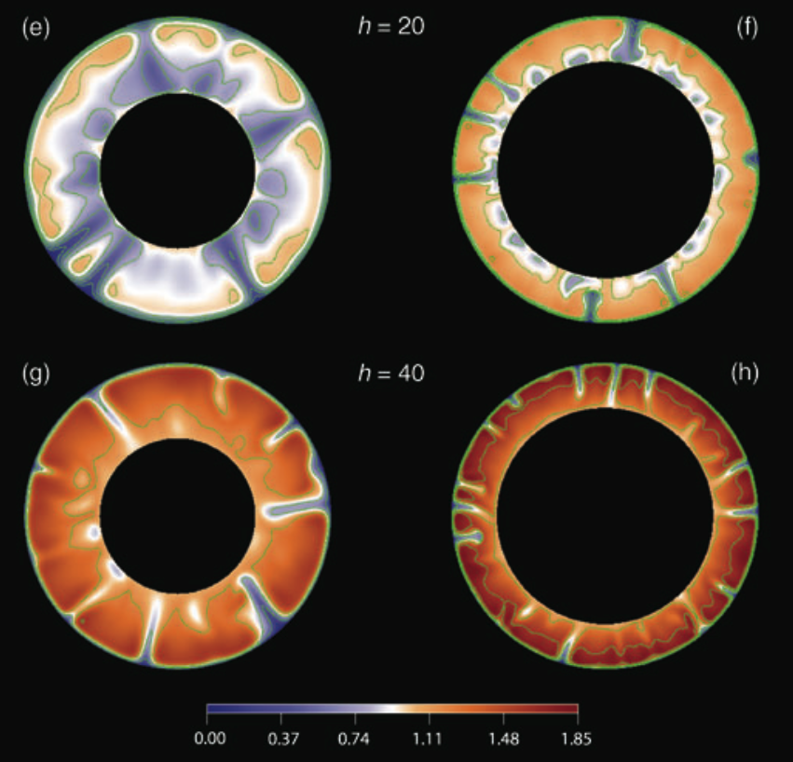
Mantle Convection:
Effect of Internal Heating
Internal heating increases
the importance of the
top boundary layer
(the lithosphere)
Deschamps et al., 2010

Slide 18
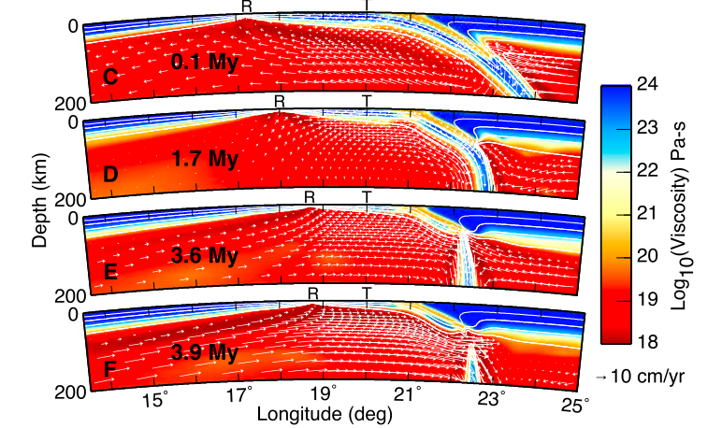
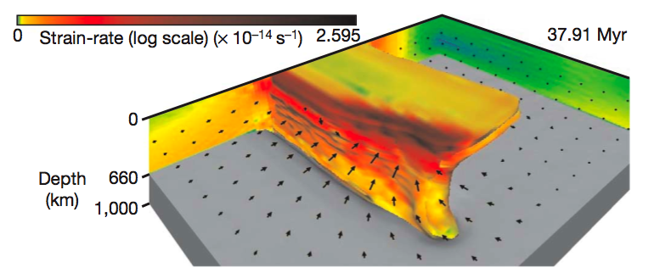
Subduction
and Slabs
form a
crucial part
of convection
on Earth
Burkett &
Billen [2009]
Schellart et al [2007]

Slide 19
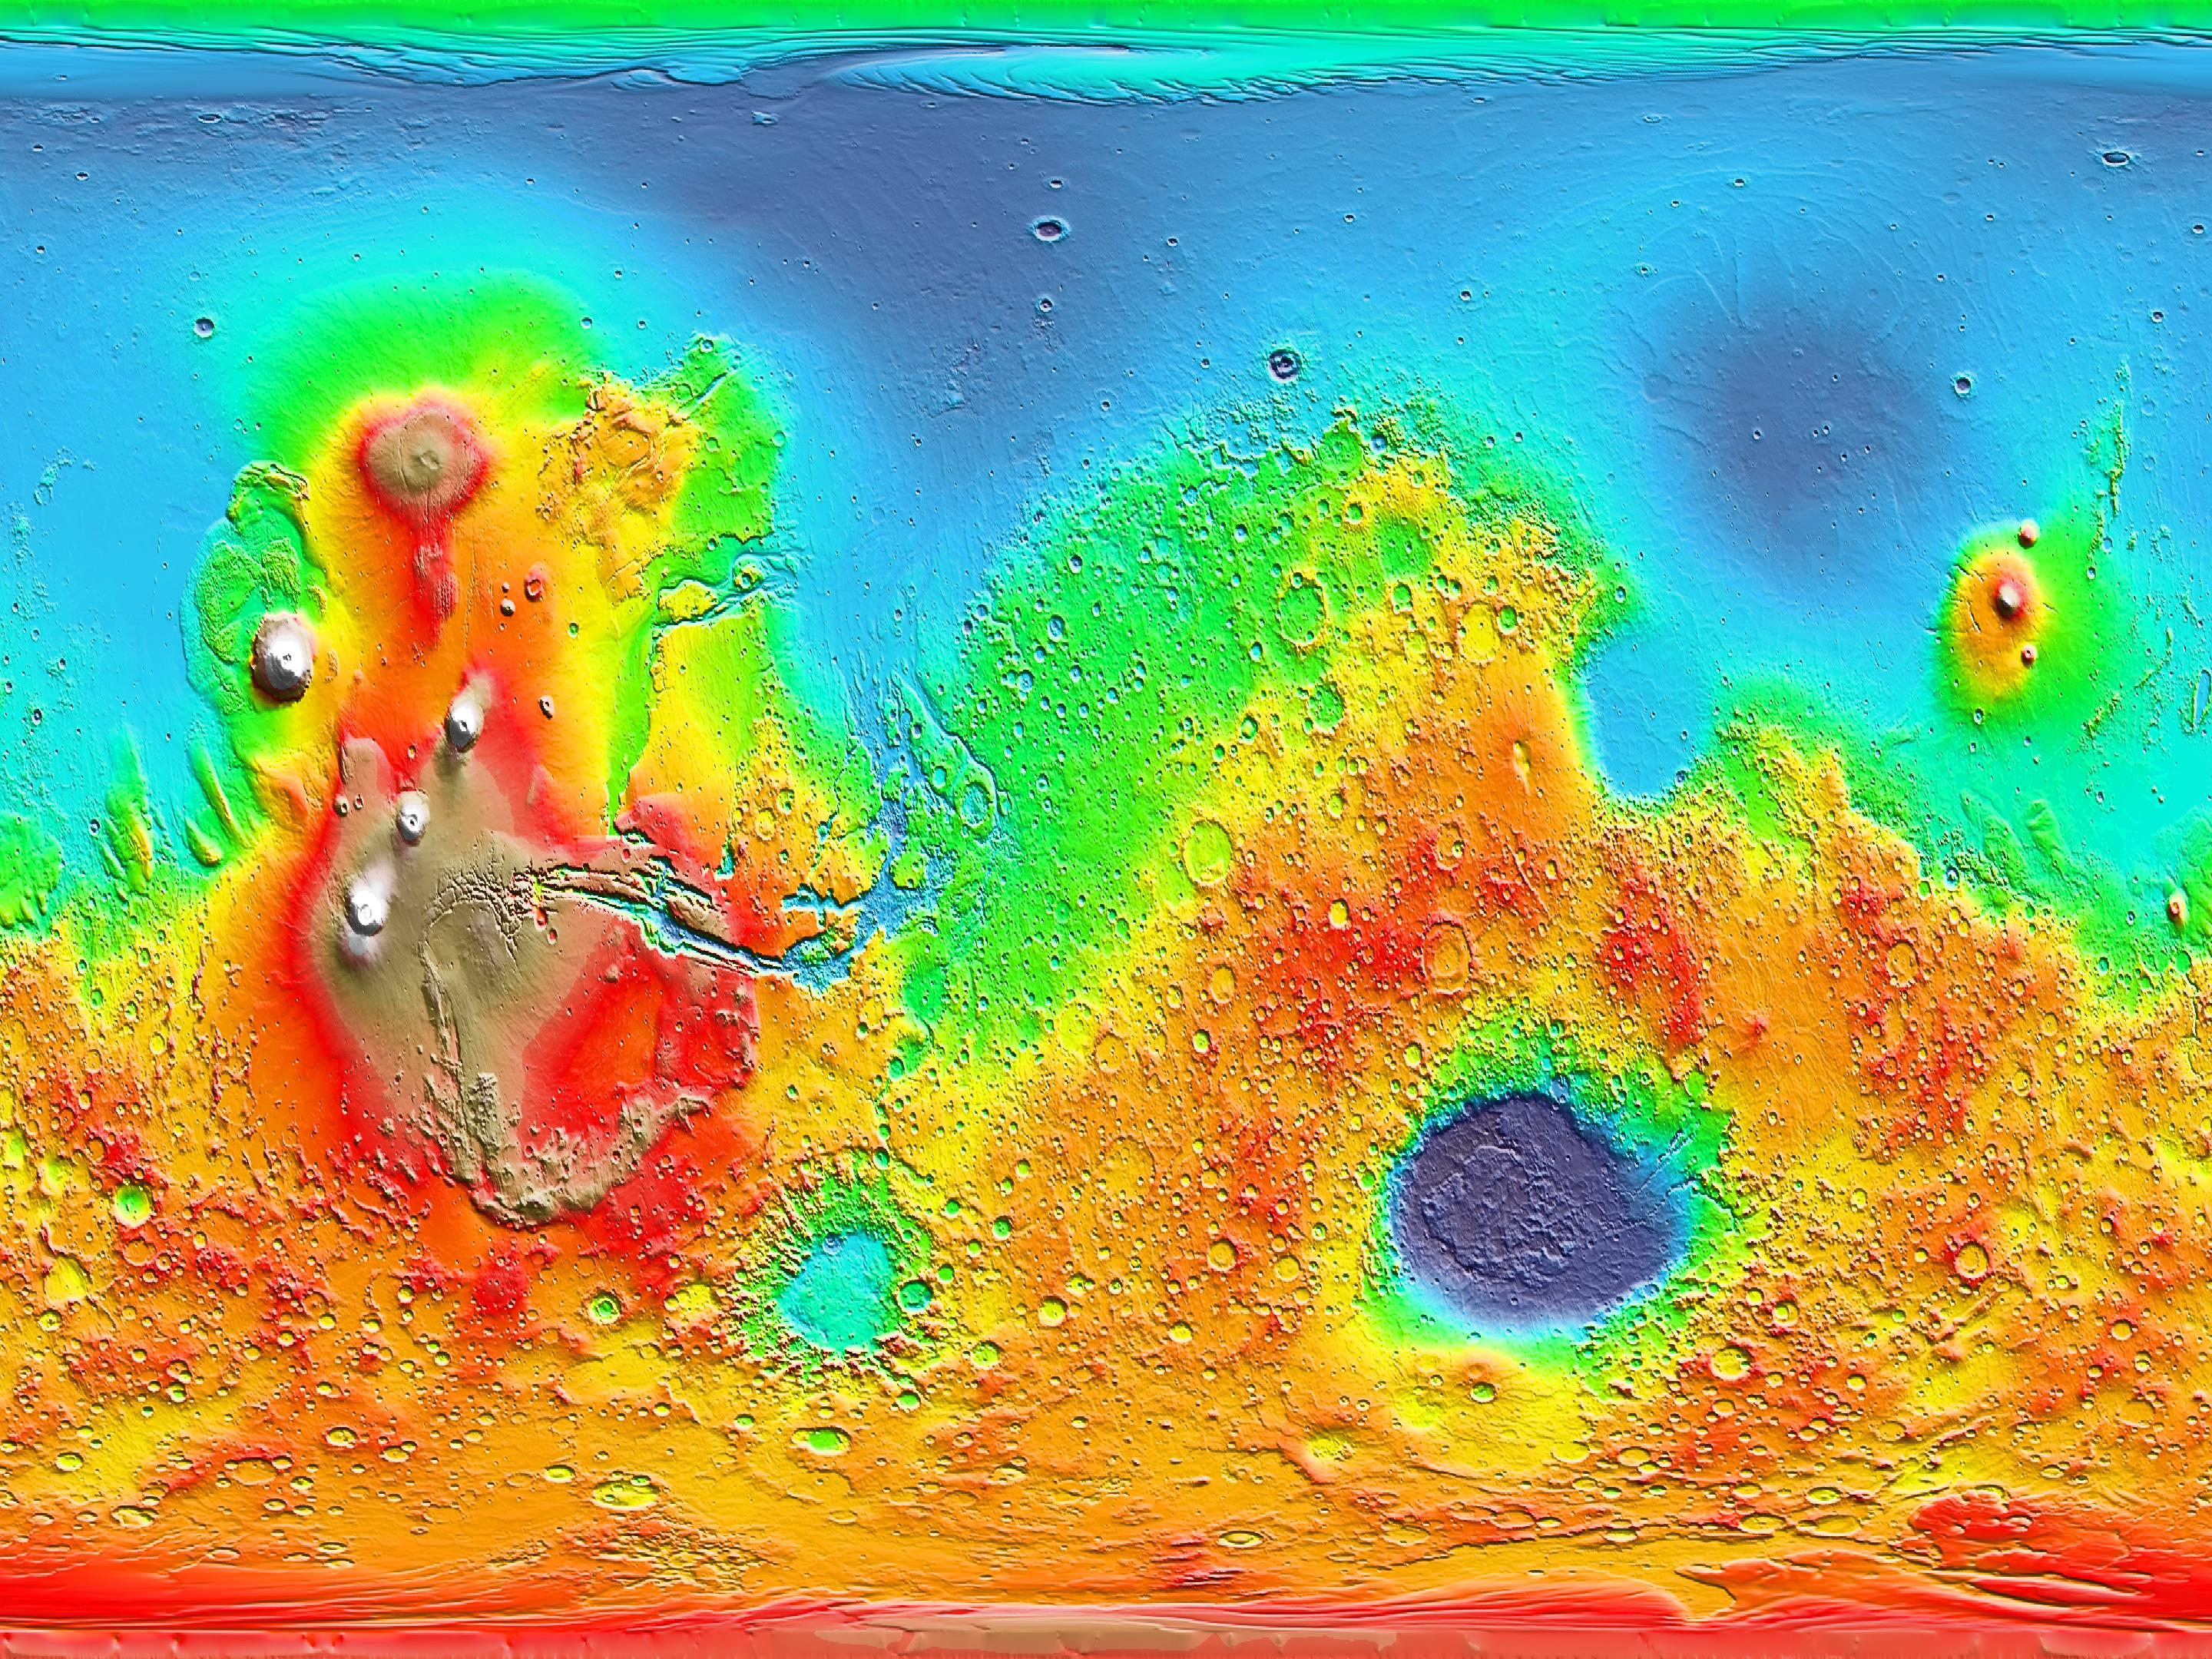
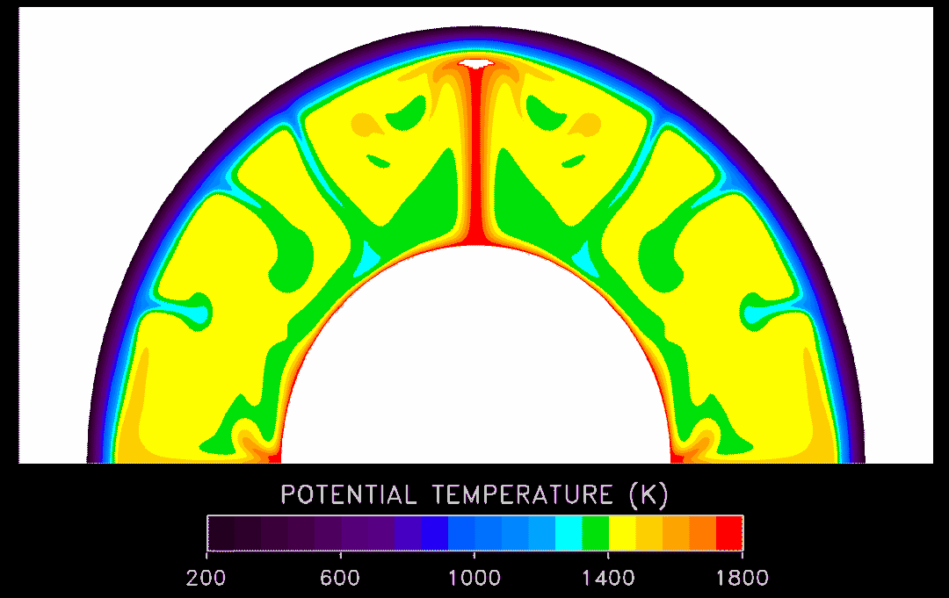
Plate Tectonics and Convection on other Planets?
Moon, Mars, Venus, Mercury: Surfaces are much
older than Earth's: Probably no plate tectonics
Instead, mantle convection may take a different form
Mars Topography
Model of Mars Convection

Slide 20
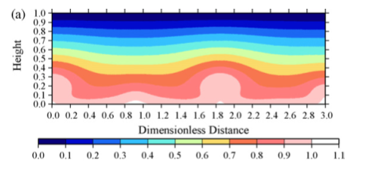
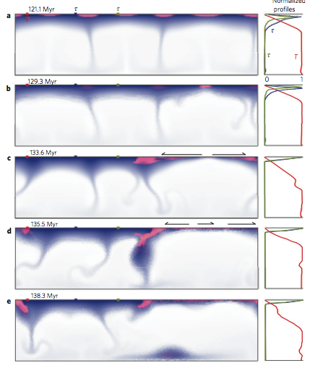
Mercury: Low Ra
Icy convection on Enceladus
Redmond & King 2007
ONeill & Nimmo 2010

Slide 21
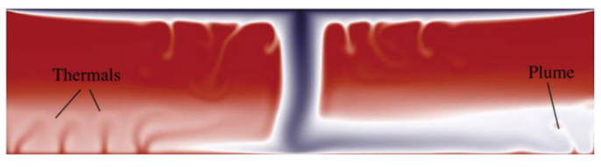
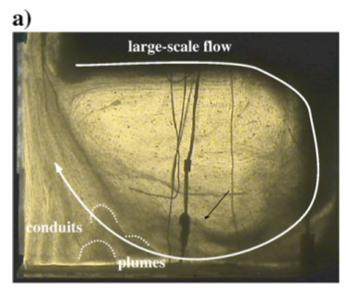
Episodic convection
on Venus
Robin et al., 2007

Slide 22
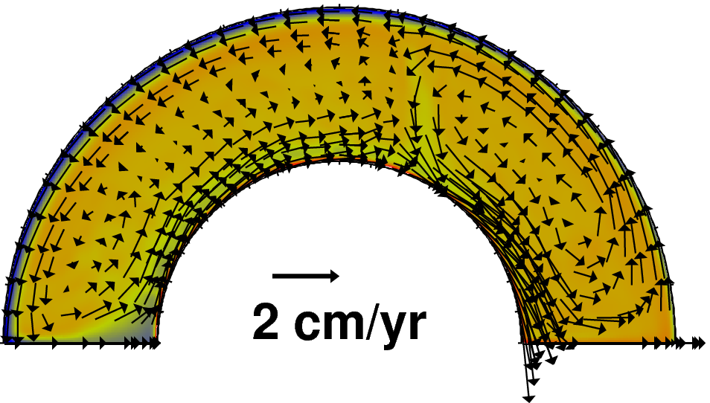
Exoplanets: Tidally-locked example
HOT
SIDE
(star)
COLD
SIDE
(night)
van Summeren, Conrad, & Gaidos, 2011

Slide 23
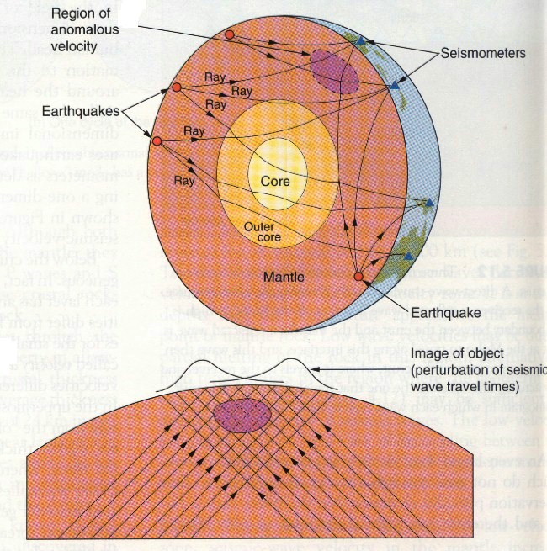
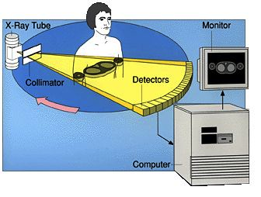
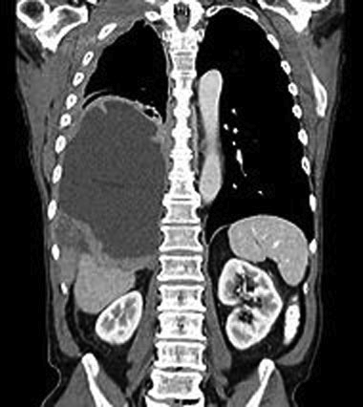
Observing Convection in the Earth: Seismic Tomography
Cat-Scan

Slide 24
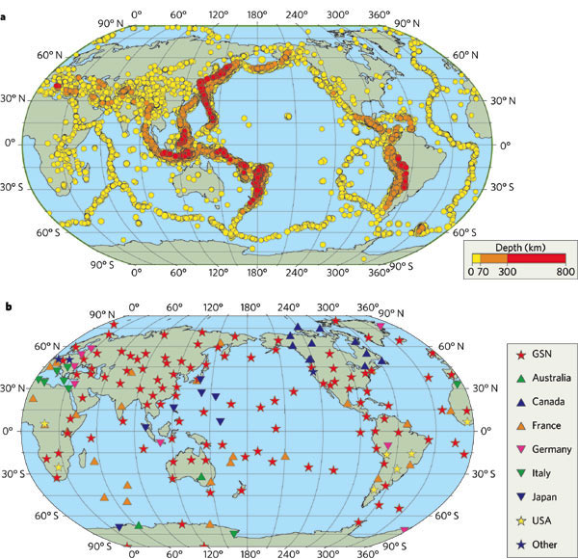

Slide 25
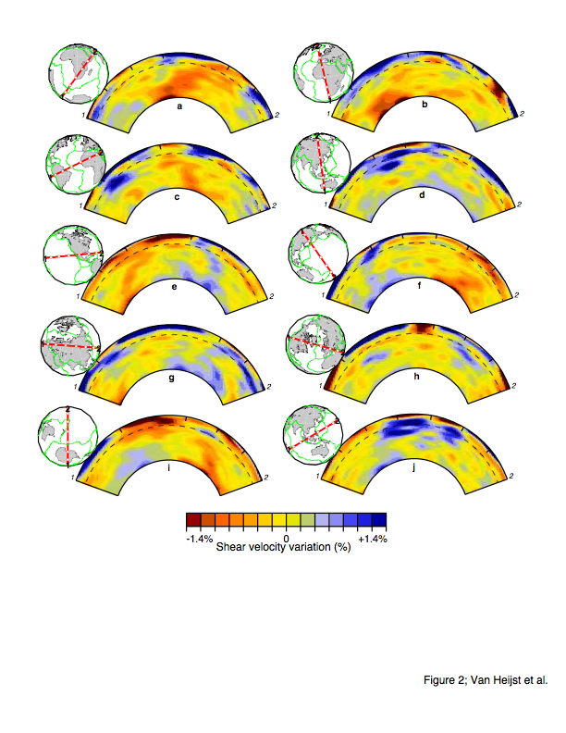

Slide 26
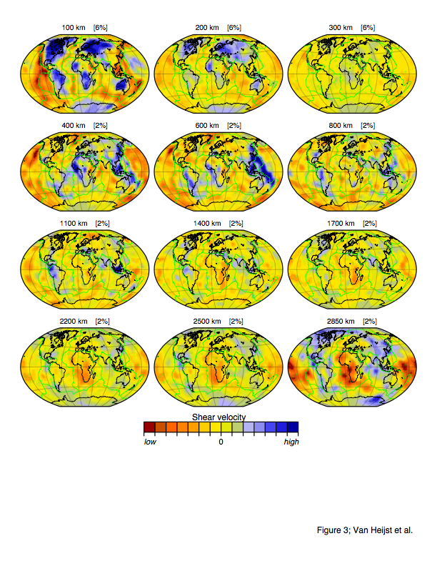

Slide 27
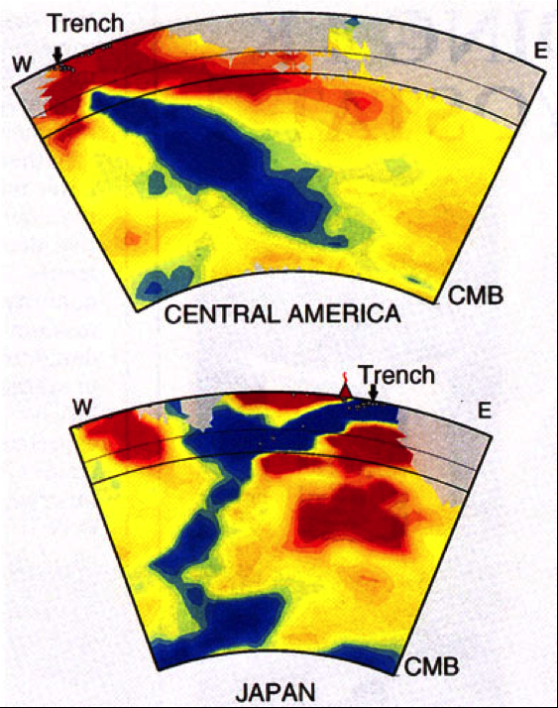
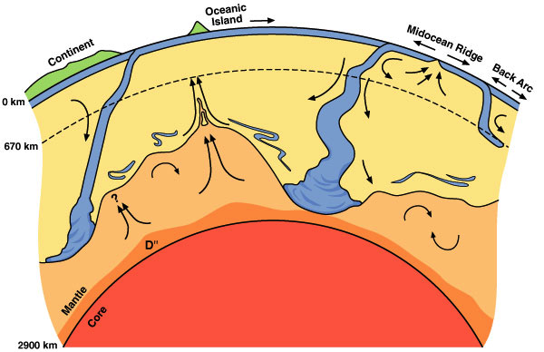
Slabs

Slide 28
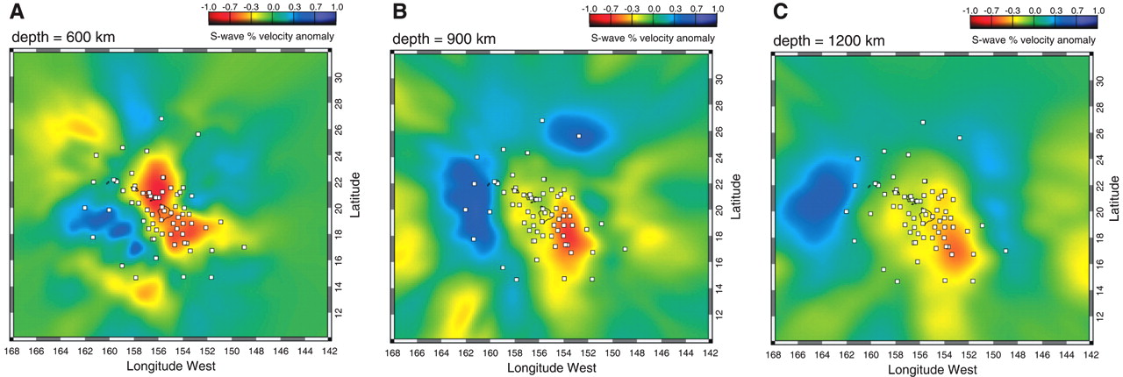
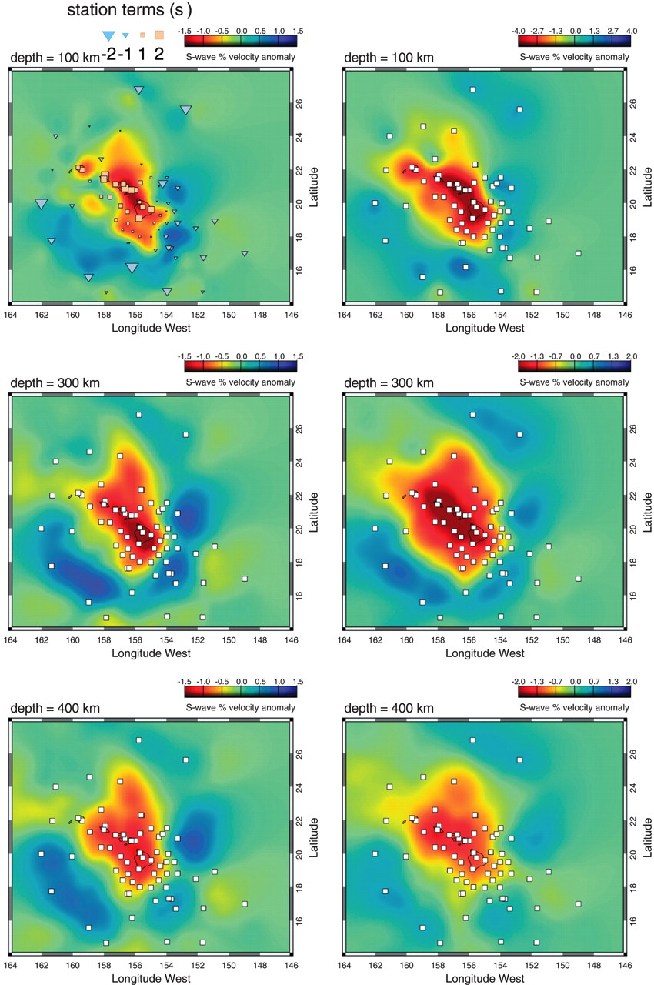
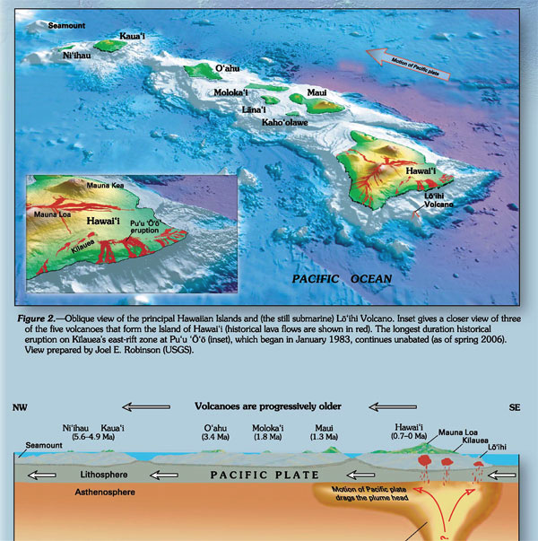
Plumes (Hawaii)
Wolfe et al (2009)

Slide 29
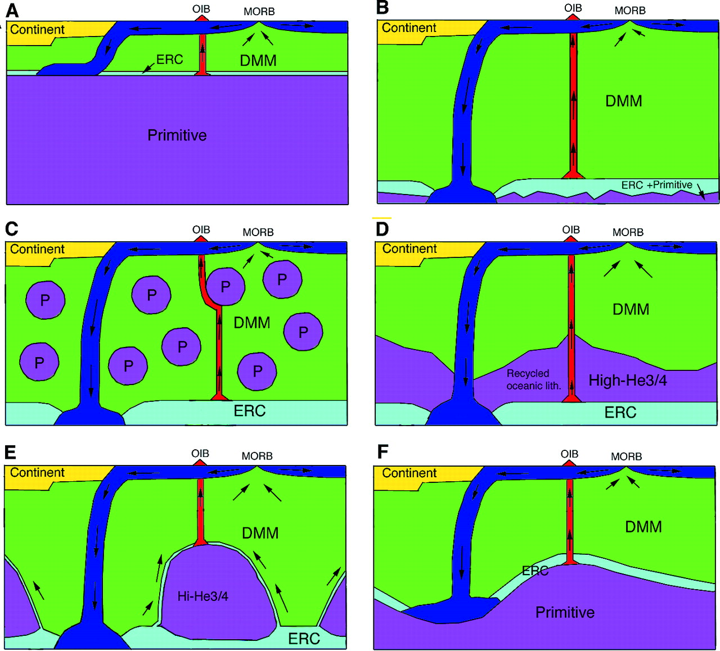
Structure of Mantle Convection
Tackley
[2000]

Slide 30
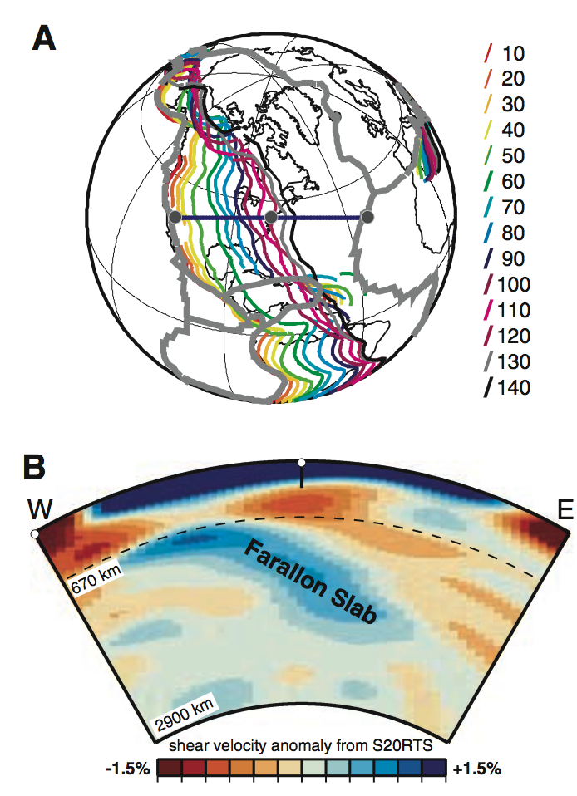
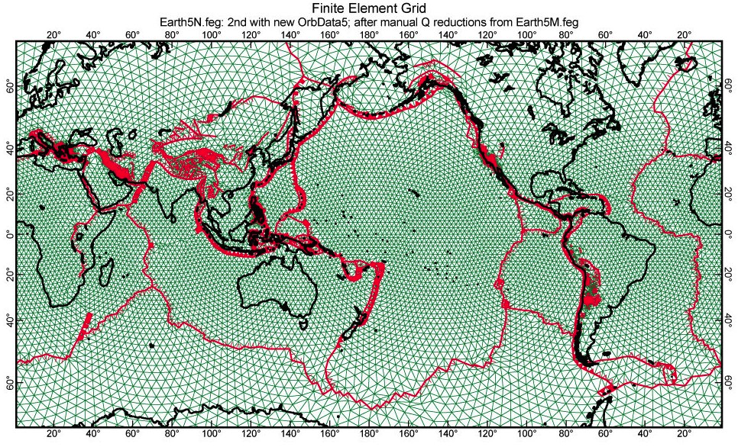
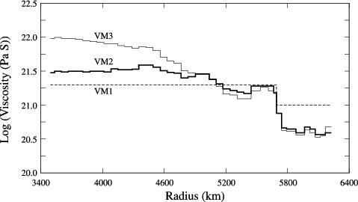
Numerical Models of Mantle Convection
Input:
1. Mantle Densities
(from seismic tomography)
2. Mantle Viscosity Structure
(from postglacial rebound)
3. A Finite Element Code

Slide 31
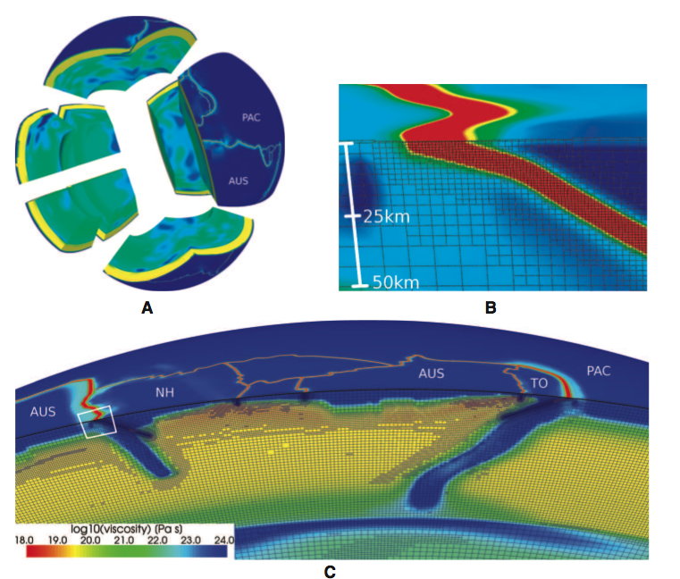
State of the Art: Adaptive Mesh Refinement & Slabs
Stadler et al.,
Science 2010

Slide 32
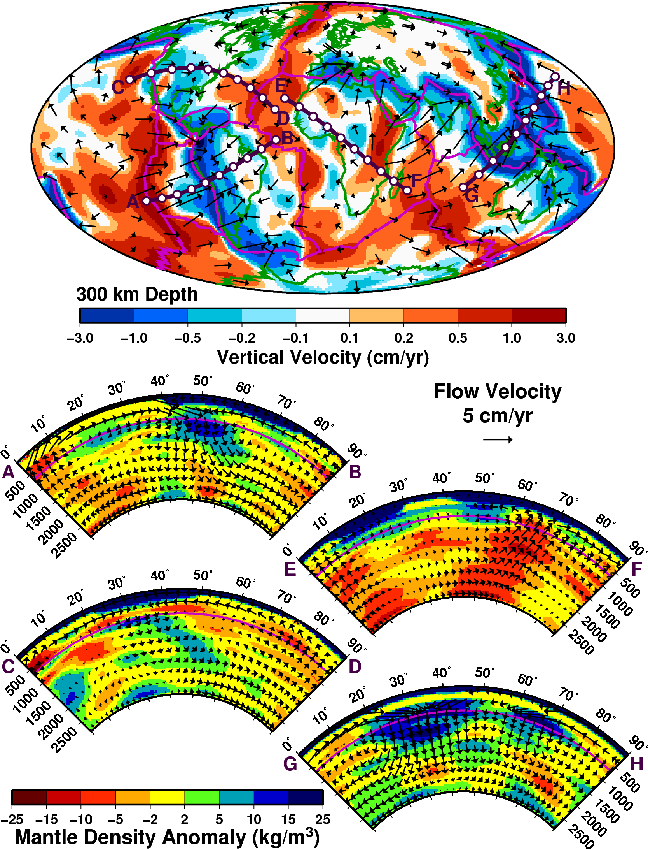
Predictions of Numerical
Convection Models:
Mantle Flow Field

Slide 33
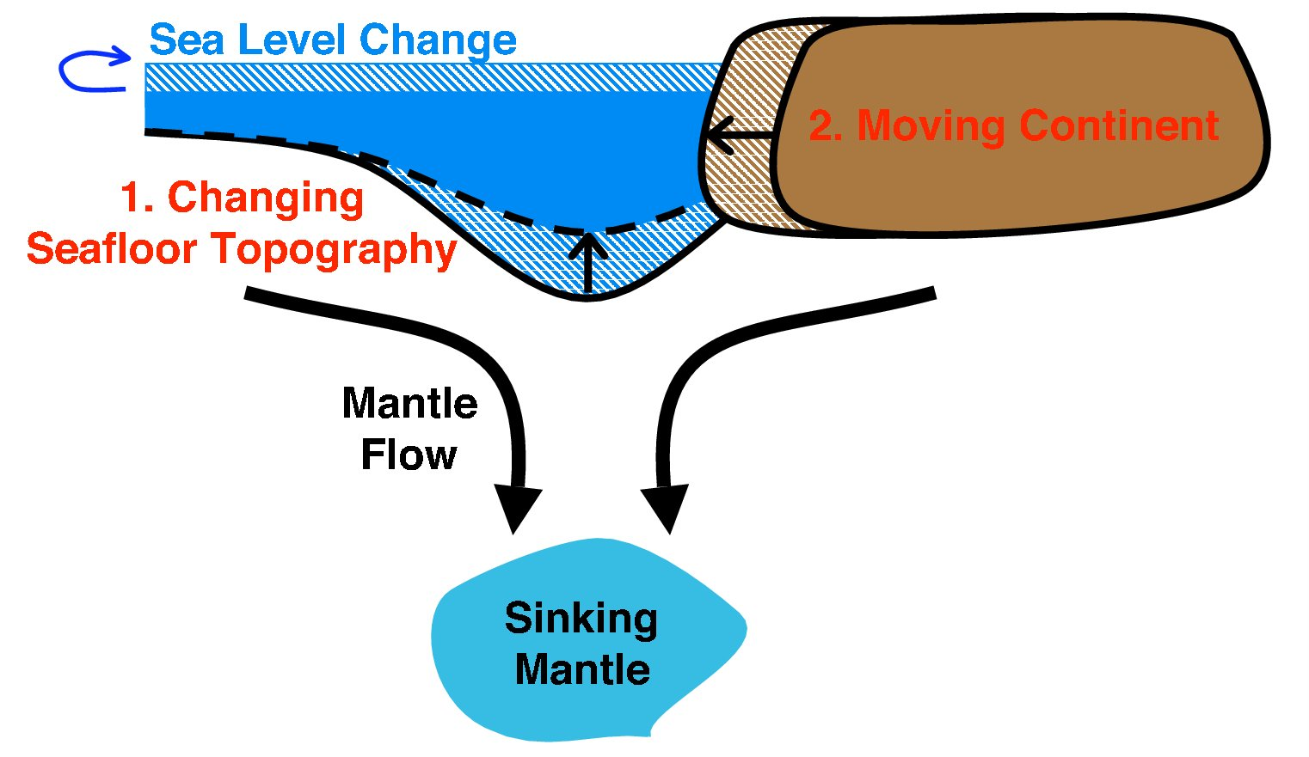
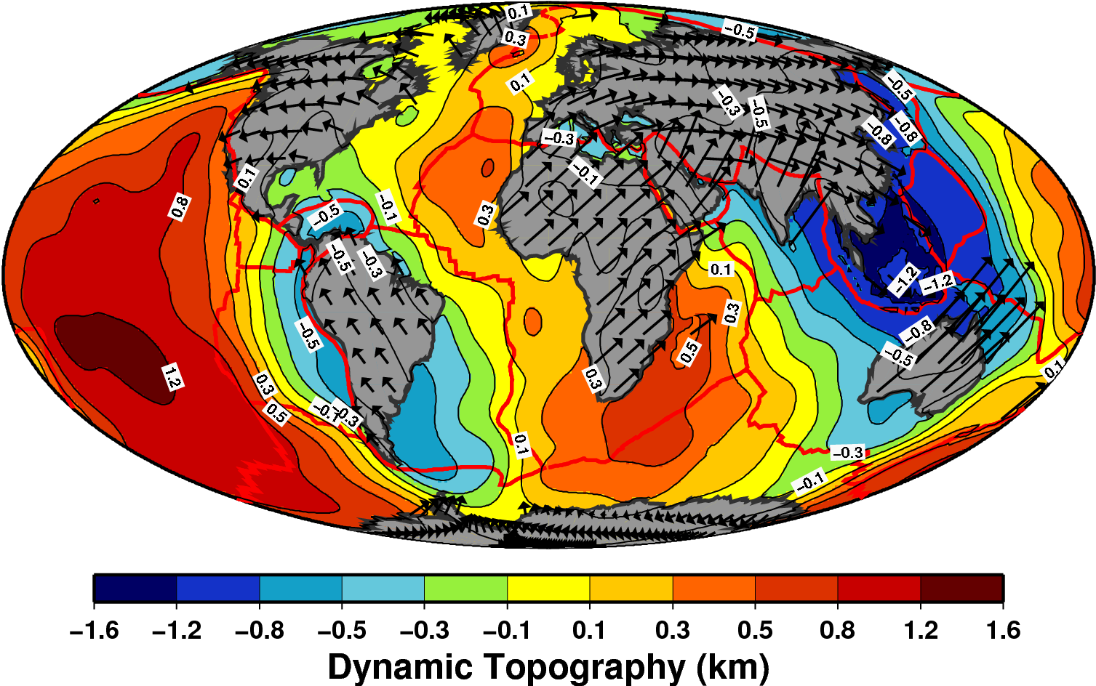
Predictions of Numerical
Convection Models:
Dynamic Uplift
Conrad & Husson, 2009

Slide 34
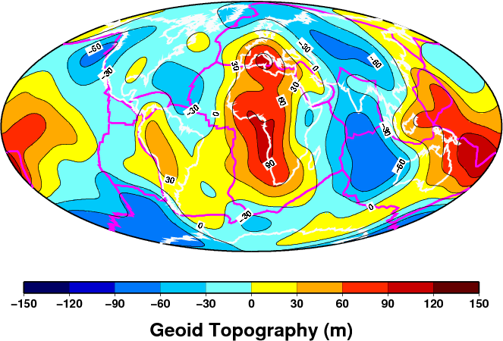
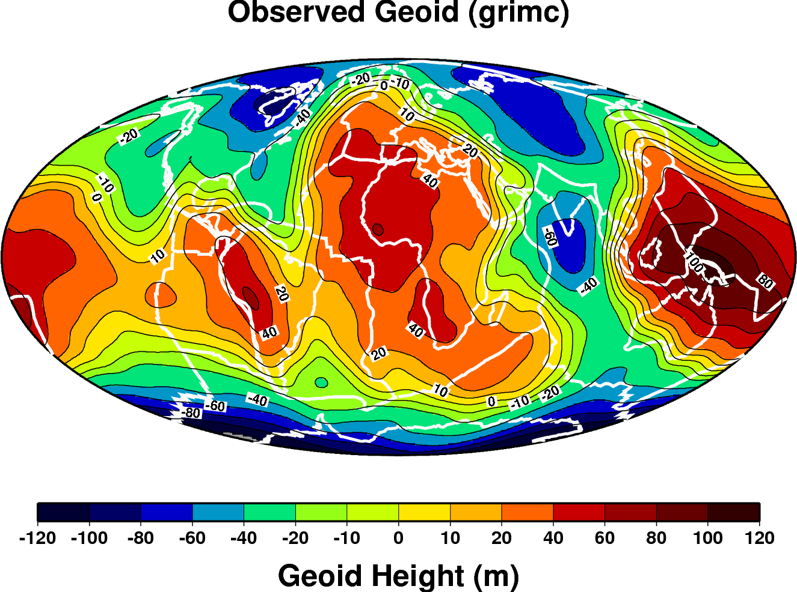
Predictions of Numerical
Convection Models:
Earth’s Shape
(the Geoid)

Slide 35
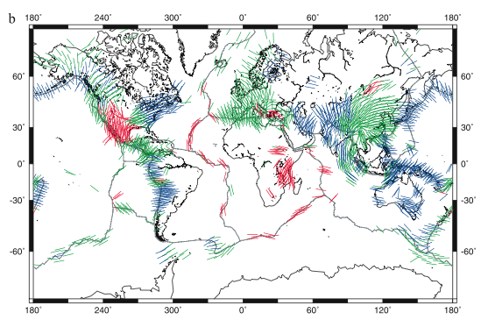


Predictions of
Numerical
Convection Models:
Lithospheric
Stresses
Lithgow-Bertelloni &
Guynn, 2004

Slide 36


Predictions of Numerical
Convection Models:
Anisotropic Fabric
Conrad
et al.,
2007

Slide 37

Predictions of Numerical
Convection Models:
Plate Motions
Conrad & Lithgow-Bertelloni [2004]

Slide 38

Observed
Predicted
Predictions of
Numerical
Convection Models:
Time-Dependence
of Plate Motions
Conrad &
Lithgow-Bertelloni [2004]

Slide 39

Thermal Evolution
of the Earth
1862: Lord Kelvin
How long would an initially
molten earth take to cool at
present cooling rates?
20 to 100 Million years
1895: John Perry
But the mantle is convecting:
2 to 3 Billion Years
1898: Marie Curie Discovered Radioactivity:
New internal heat source changes everything!
Most important elements for Earth:
Potassium, Thorium, Uranium
Earth internal heat budget it still a research topic today

Slide 40

Current thinking:
→ Estimated
volume of heat
producing elements
is small:
→ Earth cools too
rapidly
→ Possible Solution:
Plate tectonics is
less efficient than
we think?
More heat
producing
elements
Silver & Behn [2008]

