Slide 1
Faulting in the Earth

Slide 2
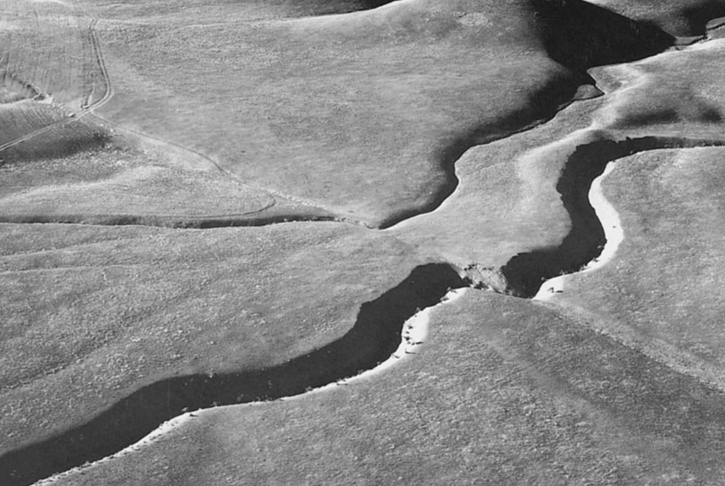
Earthquake rupture can be described in a few ways
36 mm/yr
NORTH AMERICA
PACIFIC
San Andreas Fault, Carrizo Plain
(1) Geometrically: angles or vectors describe the fault orientation and slip direction.
(2) Graphically: focal mechanisms describe two possible fault orientations and slip directions.
(3) Mathematically: moment tensors describe an oriented forces that mimics the rupture physics and can provide a moment magnitude

Slide 3
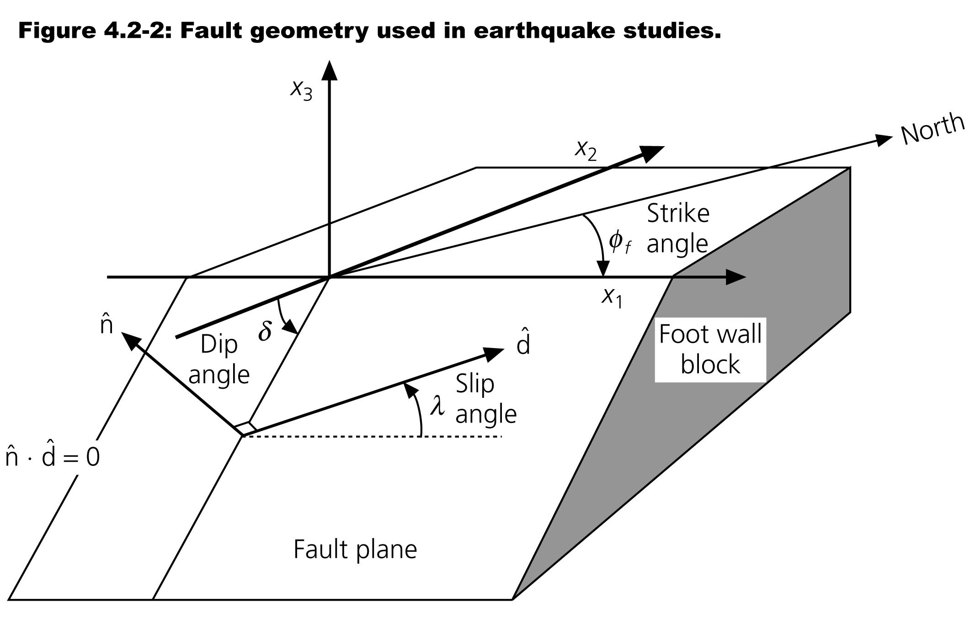
Fault Geometry Represented Geometrically
Three angles: strike φ, dip δ, slip λ, or
Two orthogonal vectors: fault normal n and slip vector d
Kanamori and Cipar, 1974
Treating the fault as rectangular, the dimension along strike is the fault length and dimension in the dip direction is the fault width.

Slide 4
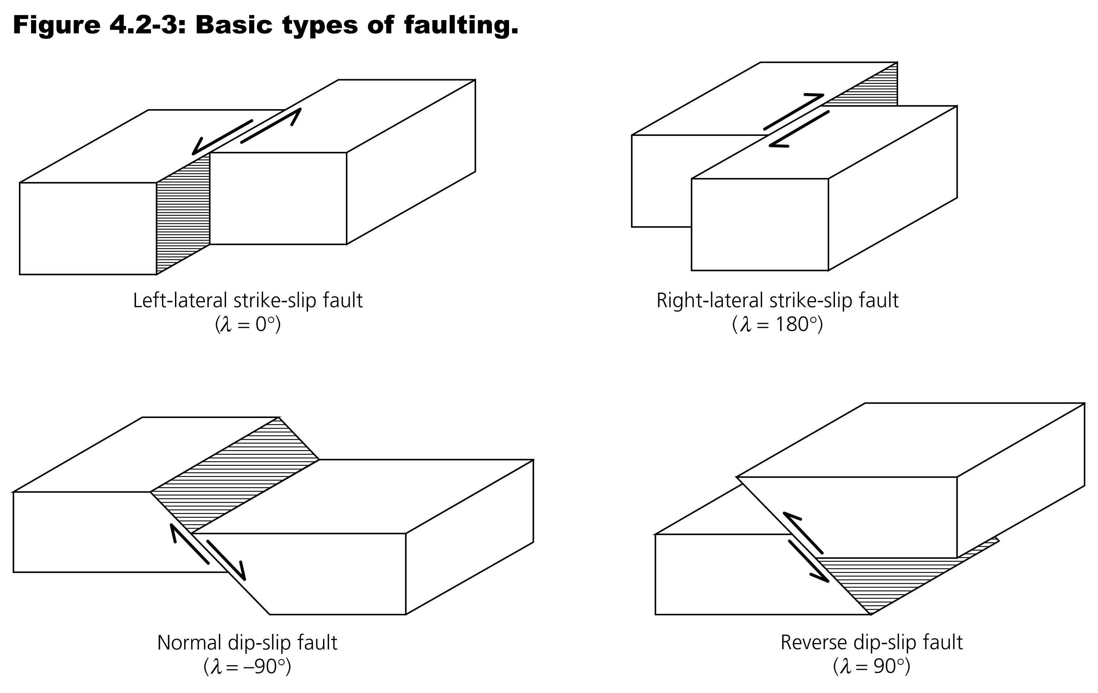
Slip Angle λ Characterizes Fault Type
Most earthquakes consist of some combination of these motions, and have slip angles between these values

Slide 5
P-wave Energy Radiation
Map View of a Strike-Slip Fault
Lithosphere deforms elastically before fault slip
Then the fault slips and the stored elastic energy is released as traveling wave energy

Slide 6
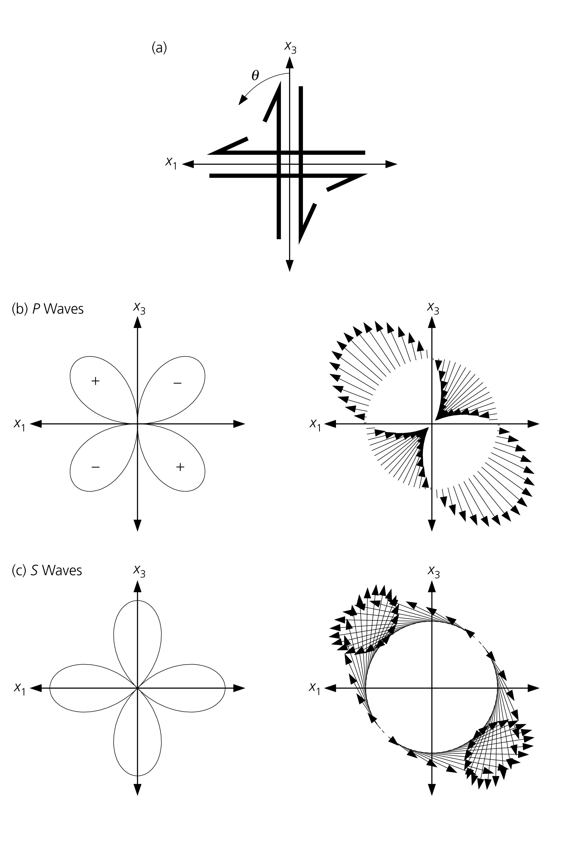
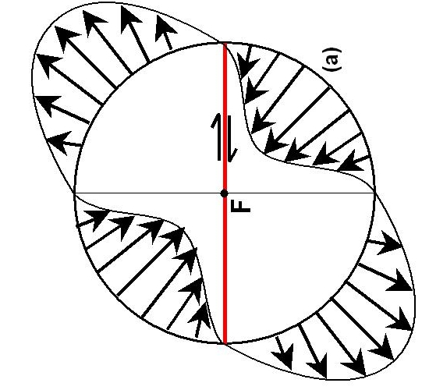
P-wave Energy Radiation
Map View of a Strike-Slip Fault
X1
X2
Around an earthquake, the first motion of the radiated wave is either compressional or dilatational.

Slide 7
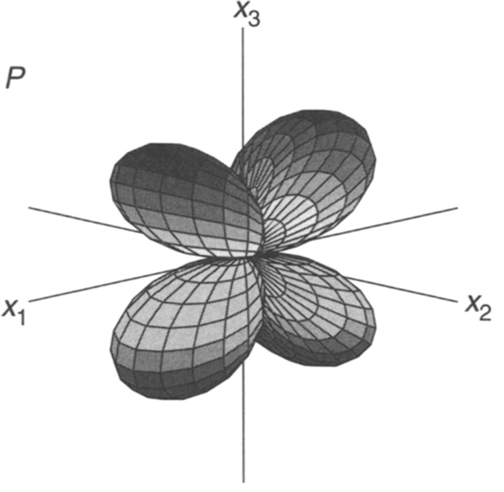
P-wave radiation lobes in 3-D
This pattern in the same for all simple faults irrespective of fault orientation
+
-
-
+
Realize that this is a plot of wave energy or amplitude, not the wave itself. The energy travels outward from the earthquake source as a spherical wave.

Slide 8
S-wave energy radiation from a shear plane source
Around an earthquake, the first motion of the radiated spherical wave is polarized either to the left or right relative to path travelled.

Slide 9
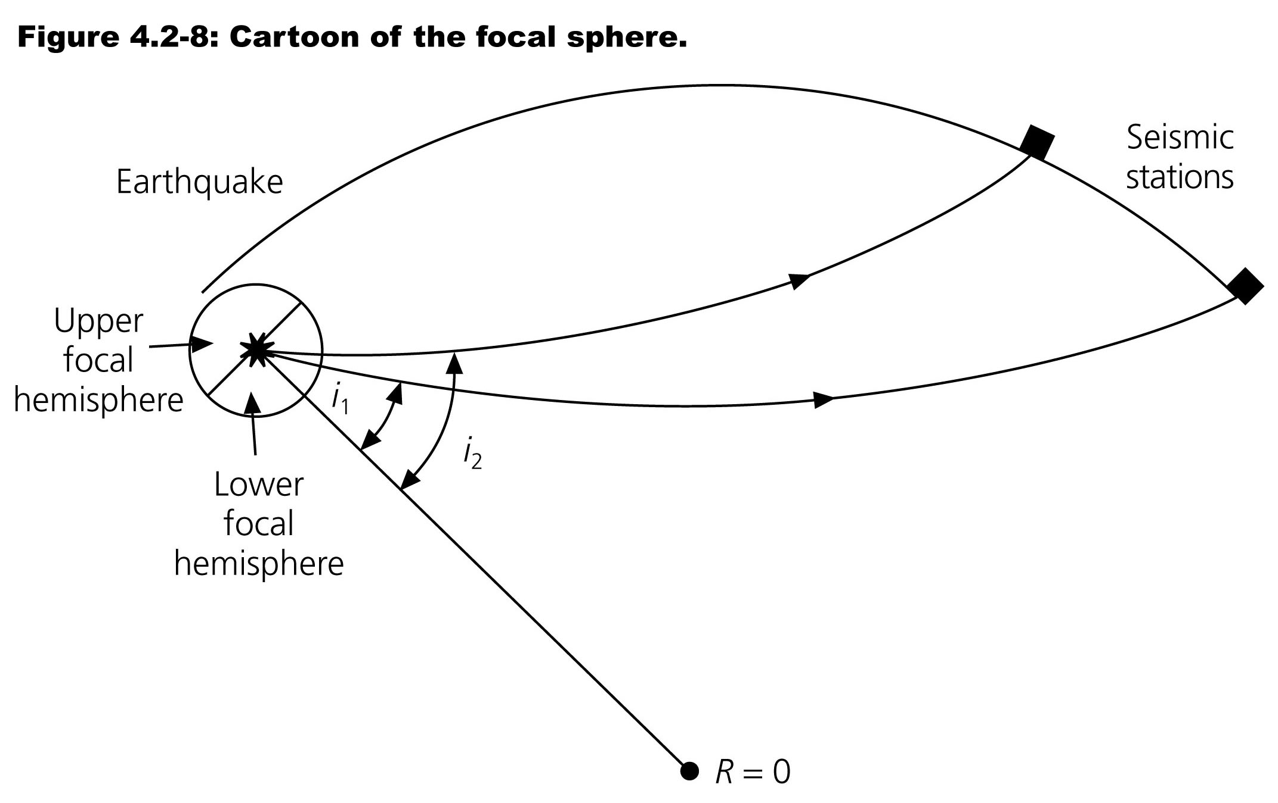
Energy radiated to distant stations is usually downward:
Seismic rays bend back up to surface due to velocity increase with depth
Stein & Wysession, 2003
Primary energy to distant stations is radiated out of lower focal hemisphere

Slide 10
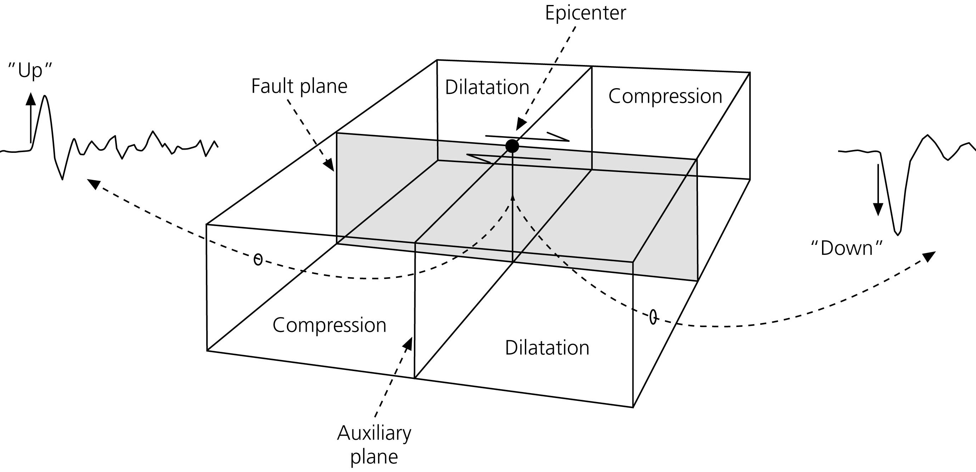
Examine the quadrants of a small box about the Earthquake rupture:
Stein & Wysession, 2003
P wave first motions
recorded
by a seismometer
We know that a P wave has either compressional or dilatational motion depending on the quadrant.
When the P wave arrives at a seismometer from below, a vertical component
seismogram records first motion up (compression) or down (dilatation).
First motions can therefore be used to define the four quadrants.

Slide 11
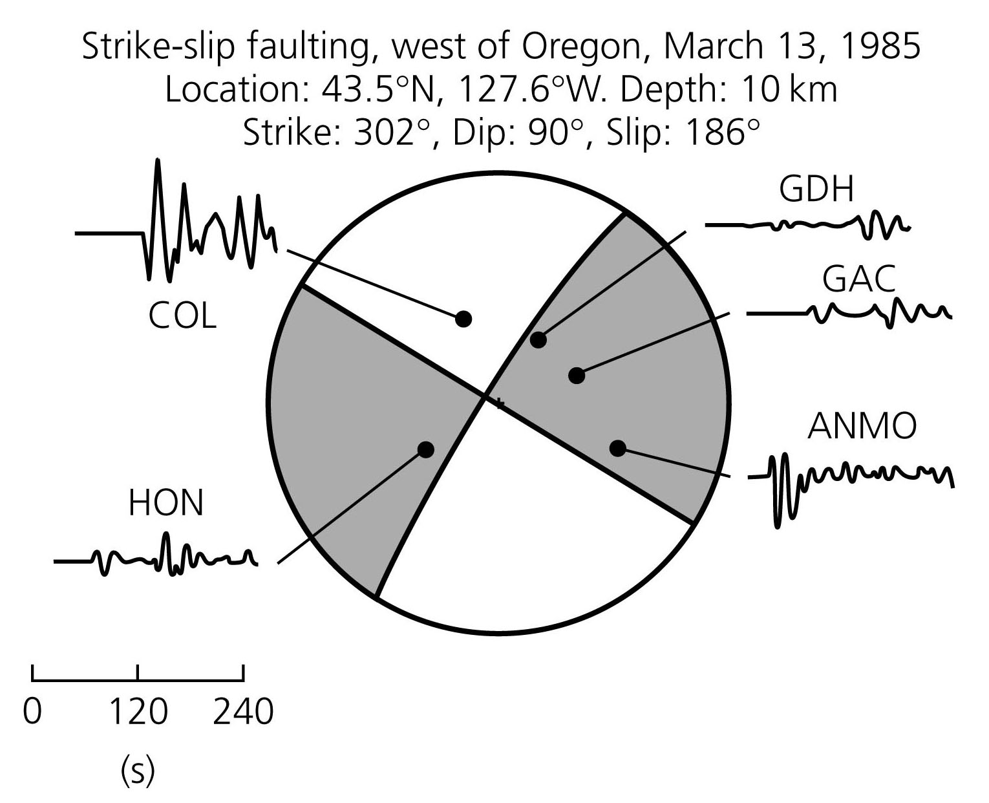
Fault Description: The Focal Mechanism
A depiction of the geometry of faulting based on the radiation pattern of wave energy
Focal mechanisms are determined using a lot of seismometers located all around the earthquake.

Slide 12
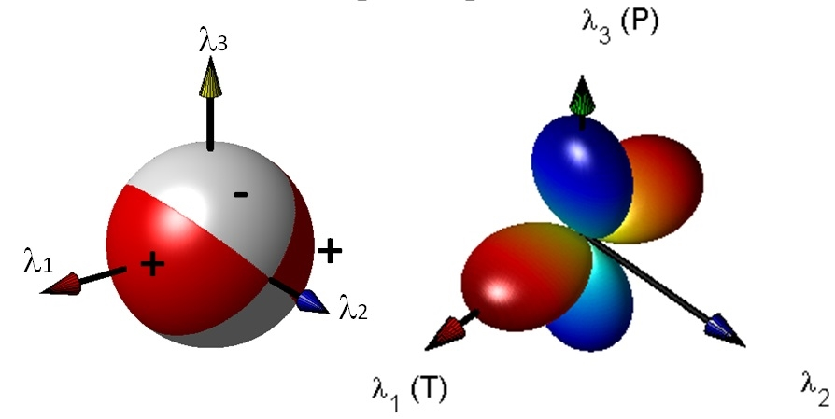
Comparison of P-wave energy lobes
and focal mechanism in 3-D

Slide 13
P wave first motions
recorded
by a seismometer
Quadrants are separated by nodal planes: the fault plane and auxiliary plane perpendicular to it.
First motions alone cannot resolve which is the actual fault plane.

Slide 14
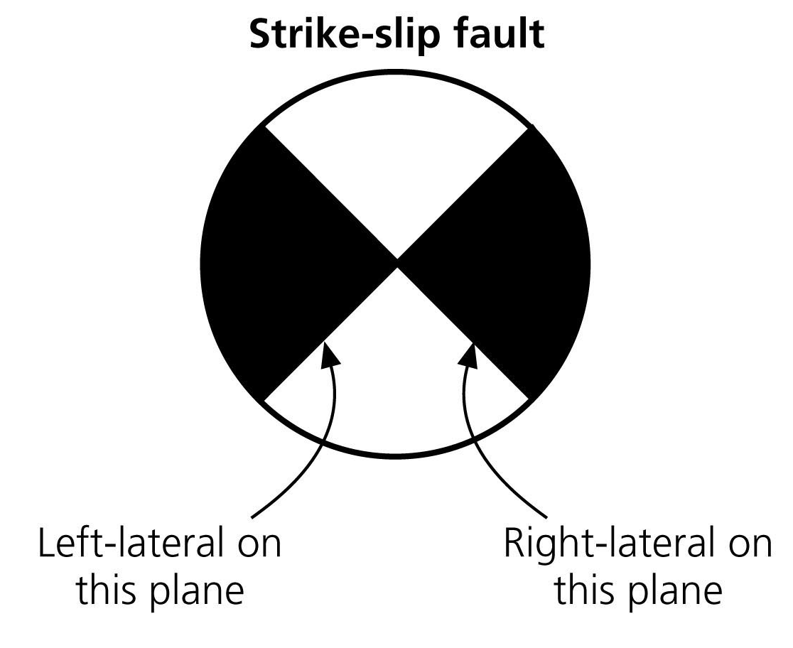
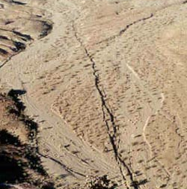
To find the fault plane:
Use geologic or geodetic information, such as the trend of the fault or observations of ground motion.
Aftershocks sometimes occur on and thus delineate the fault plane.
If the earthquake is large enough, the finite time required for slip to progress along the fault causes variations in the waveforms observed at different directions from the fault, so these directivity effects can be used to infer the fault plane.
1999 Hector Mine Earthquake (CA)
Magnitude 7.1

Slide 15
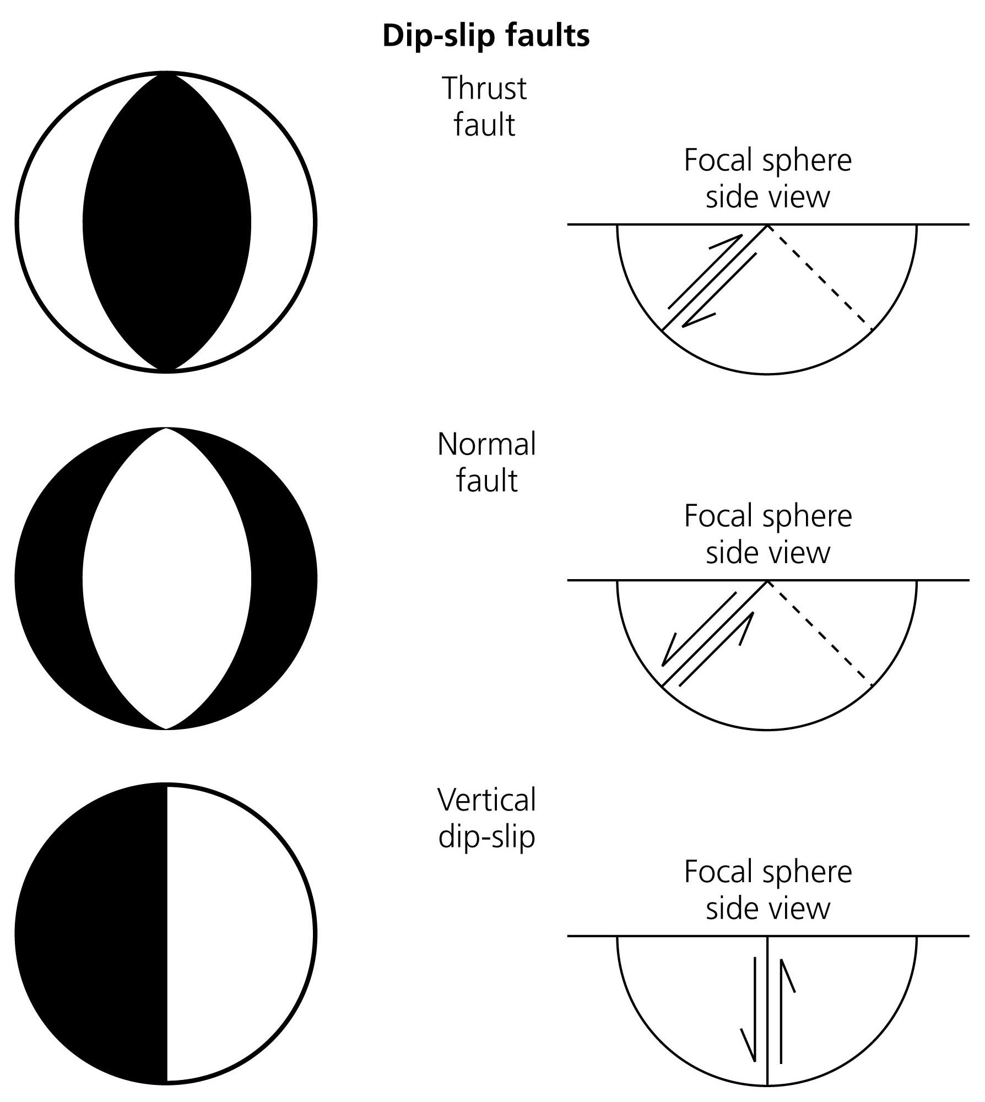
FOCAL MECHANISMS FOR BASIC FAULTS
Stein & Wysession, 2003

Slide 16
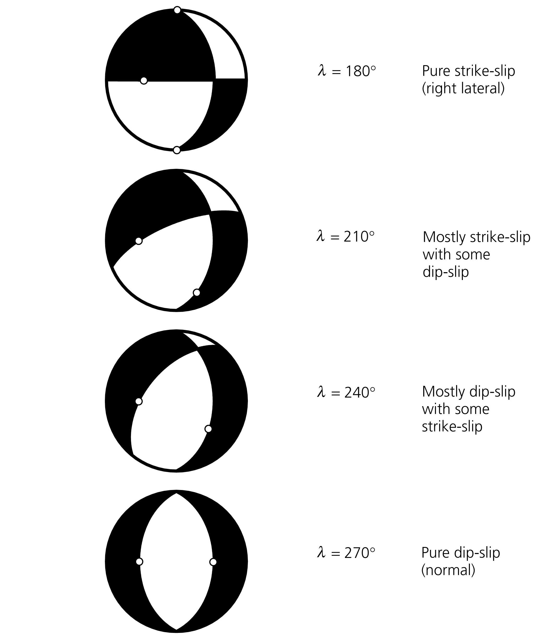
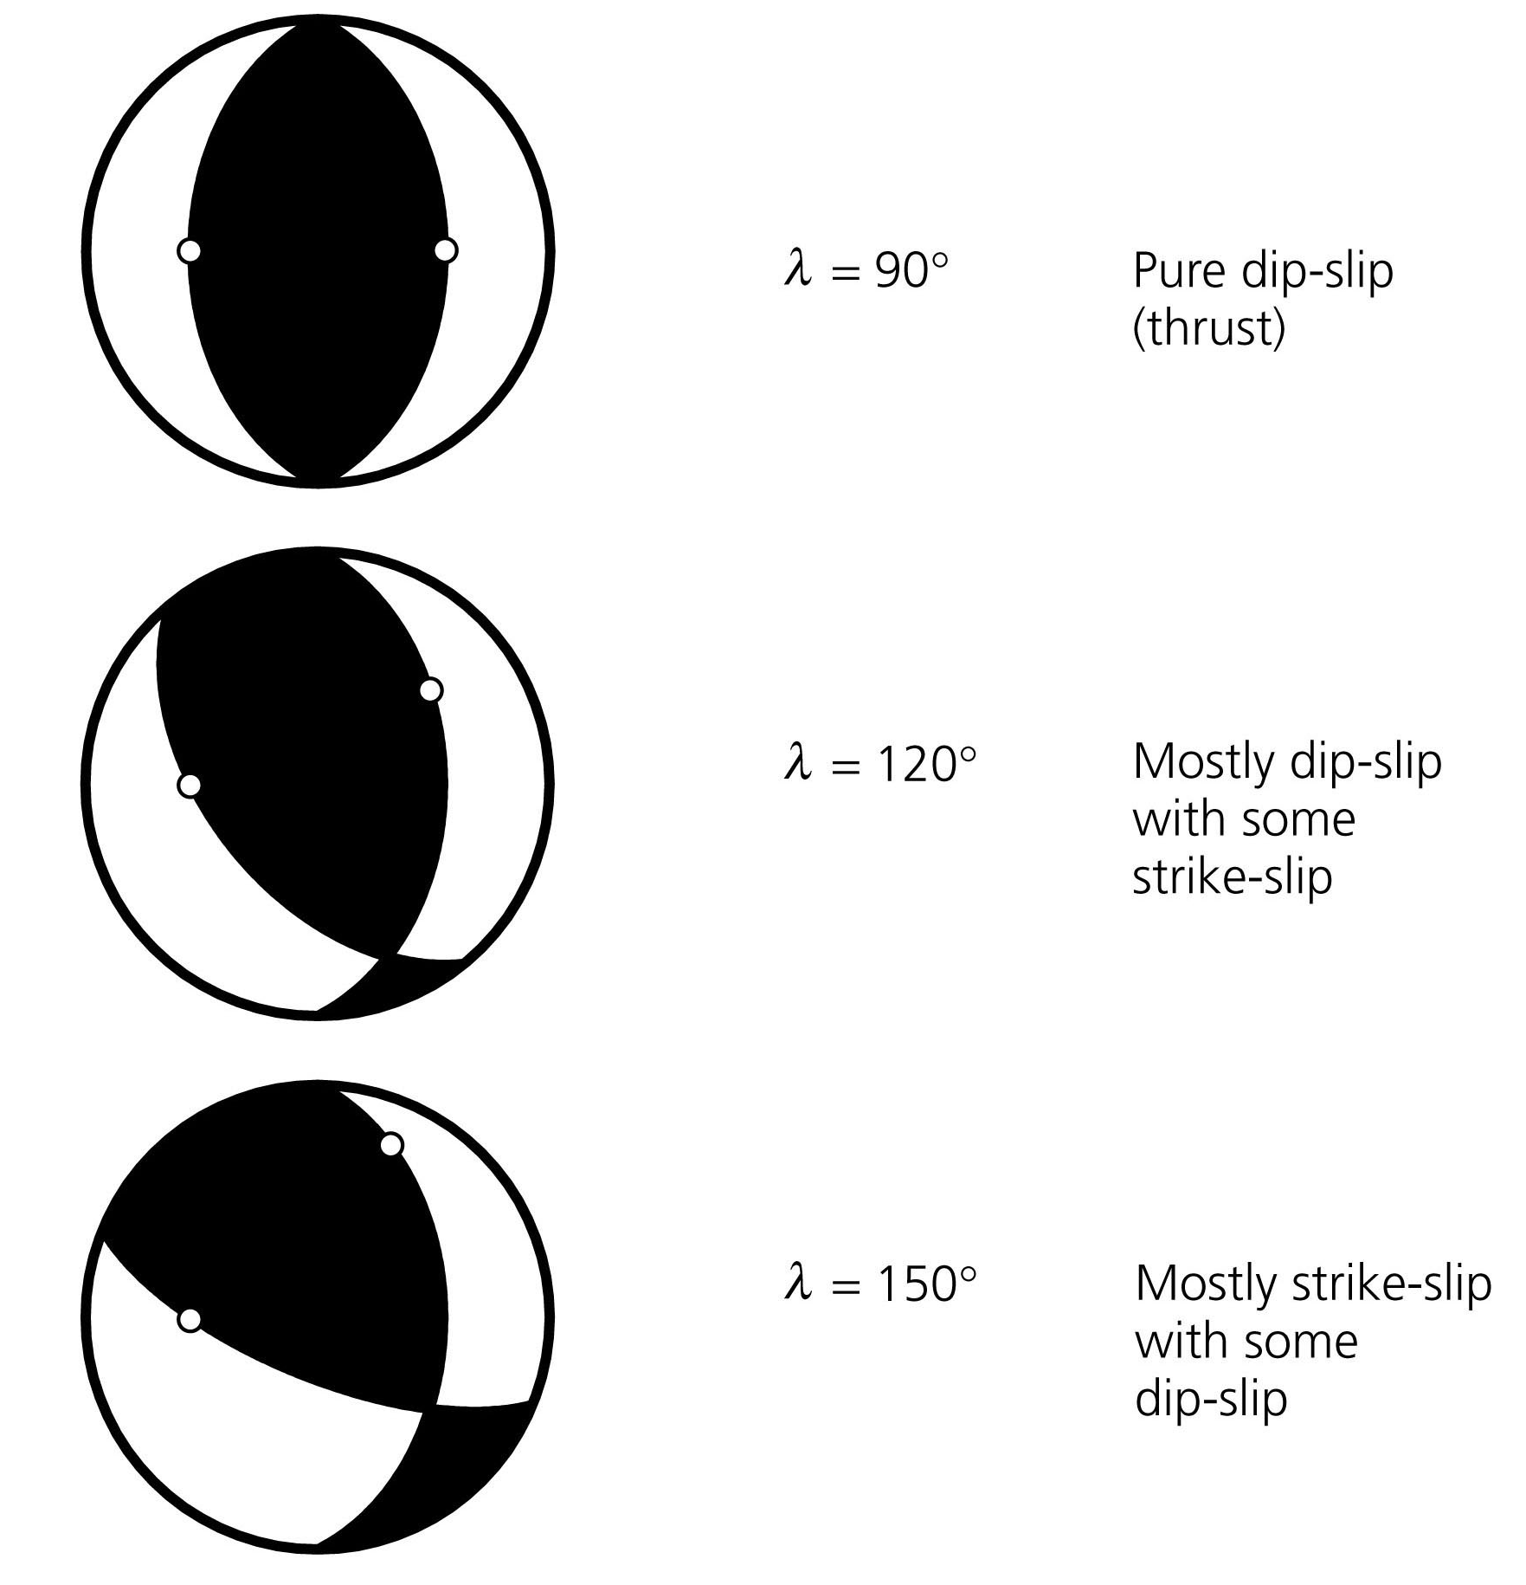
FOCAL MECHANISMS FOR DIFFERENT FAULTS
All have same N-S striking fault plane, but with varying slip angles
Stein & Wysession, 2003

Slide 17
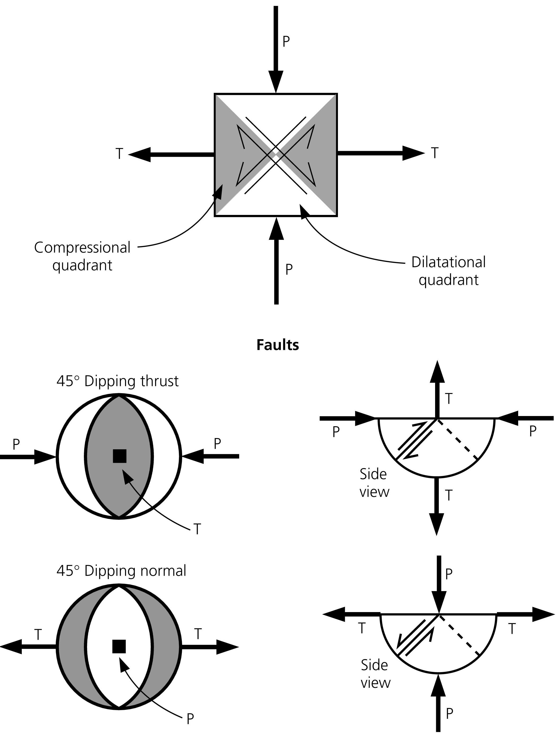
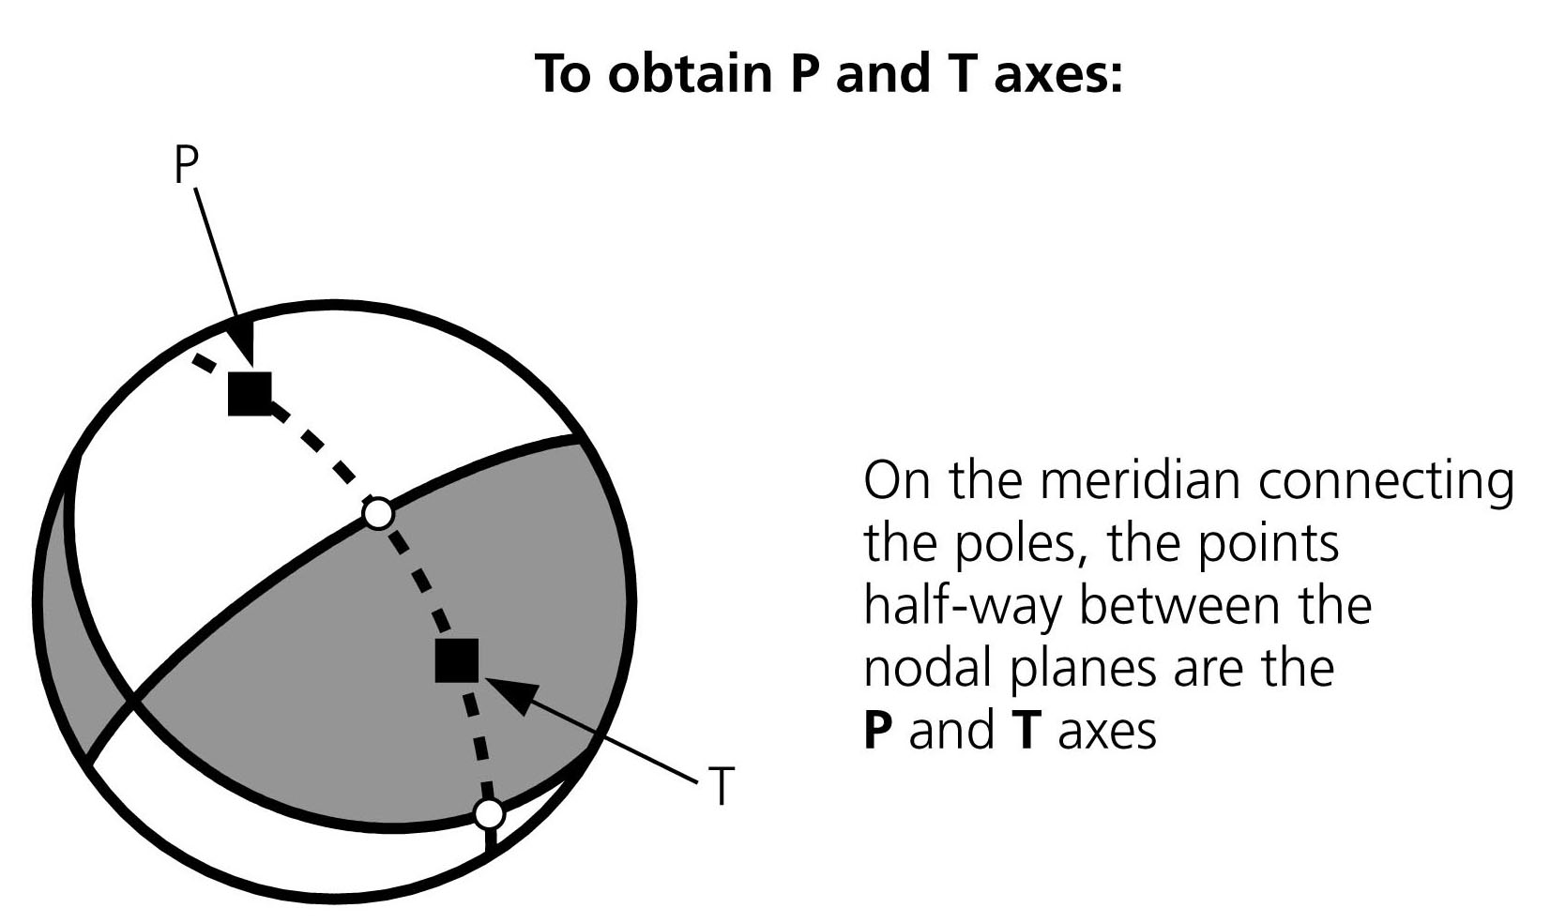
INFER STRESS ORIENTATIONS FROM FOCAL MECHANISMS
Simple model predicts faulting on planes 45° from maximum and minimum compressive stresses
These stress directions are halfway between nodal planes
Most compressive (P) and least compressive stress (T) axes can be found by bisecting the dilatational and compressional quadrants
Stein & Wysession, 2003

Slide 18
Examples

Slide 19
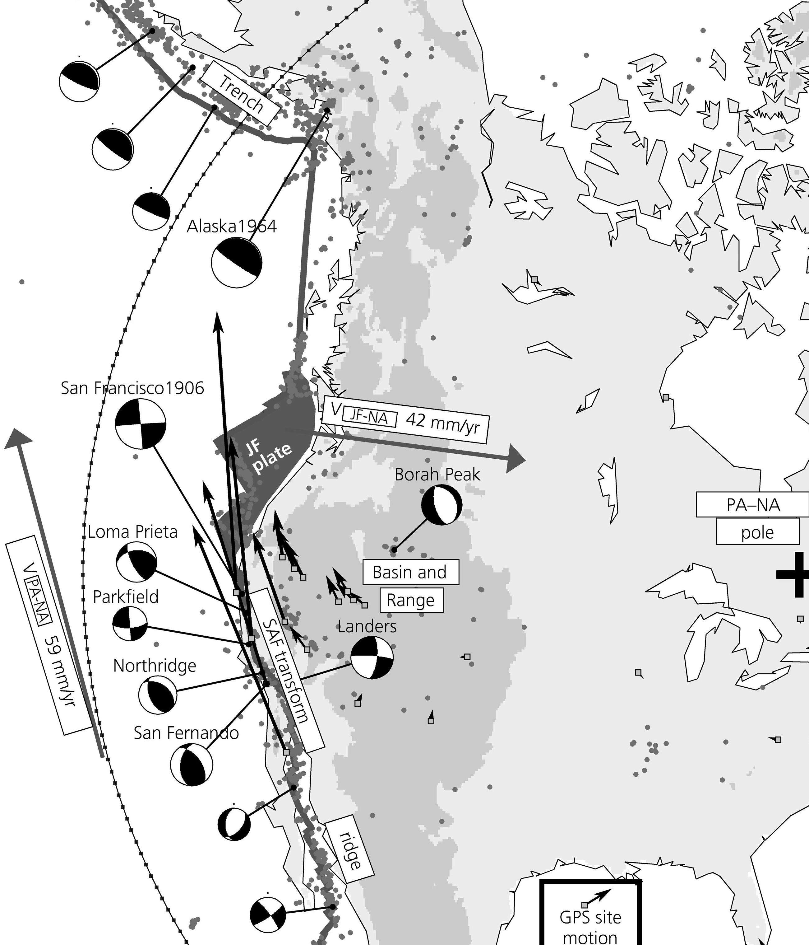
TRENCH-NORMAL
CONVERGENCE -
ALEUTIAN TRENCH
54 mm/yr
MECHANISMS show both expected plate boundary deformation
Aleutian Trench: thrust San Andreas: strike slip Gulf of California: normal & strike slip
And other boundary zone deformation
Basin & Range: normal Los Angeles Basin: thrust
BASIN & RANGE
EXTENSION
PACIFIC wrt
NORTH
AMERICA
pole
STRIKE SLIP -
SAN ANDREAS
LA BASIN
SHORTENING
EXTENSION -
GULF OF CALIFORNIA
Stein & Wysession, 2003

Slide 20
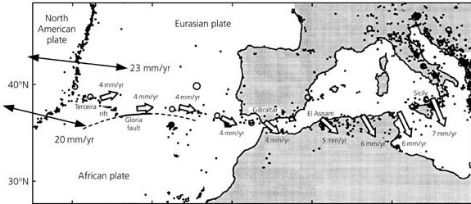
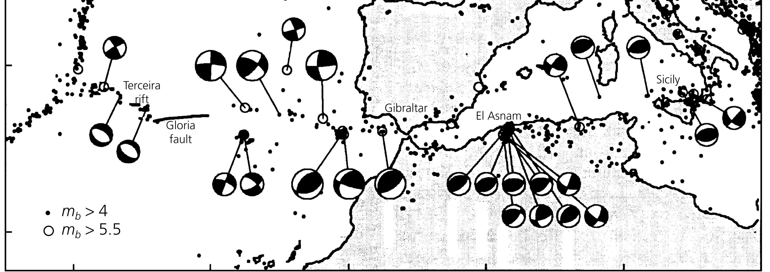
NORTH
AMERICA
EURASIA
STRIKE-SLIP
GLORIA
TRANSFORM
EXTENSION
TERCEIRA
RIFT
OBLIQUE CONVERGENCE
NORTH AFRICA
NUBIA
Argus et al., 1989

Slide 21
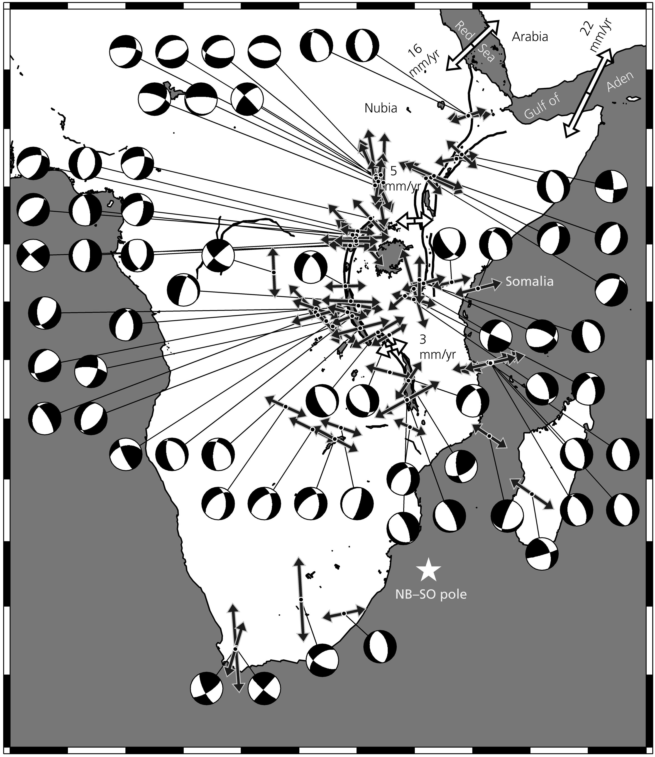
NUBIA-SOMALIA SPREADING
Normal fault mechanisms show extension across East African Rift

Slide 22
Seismic Moment Tensors

Slide 23
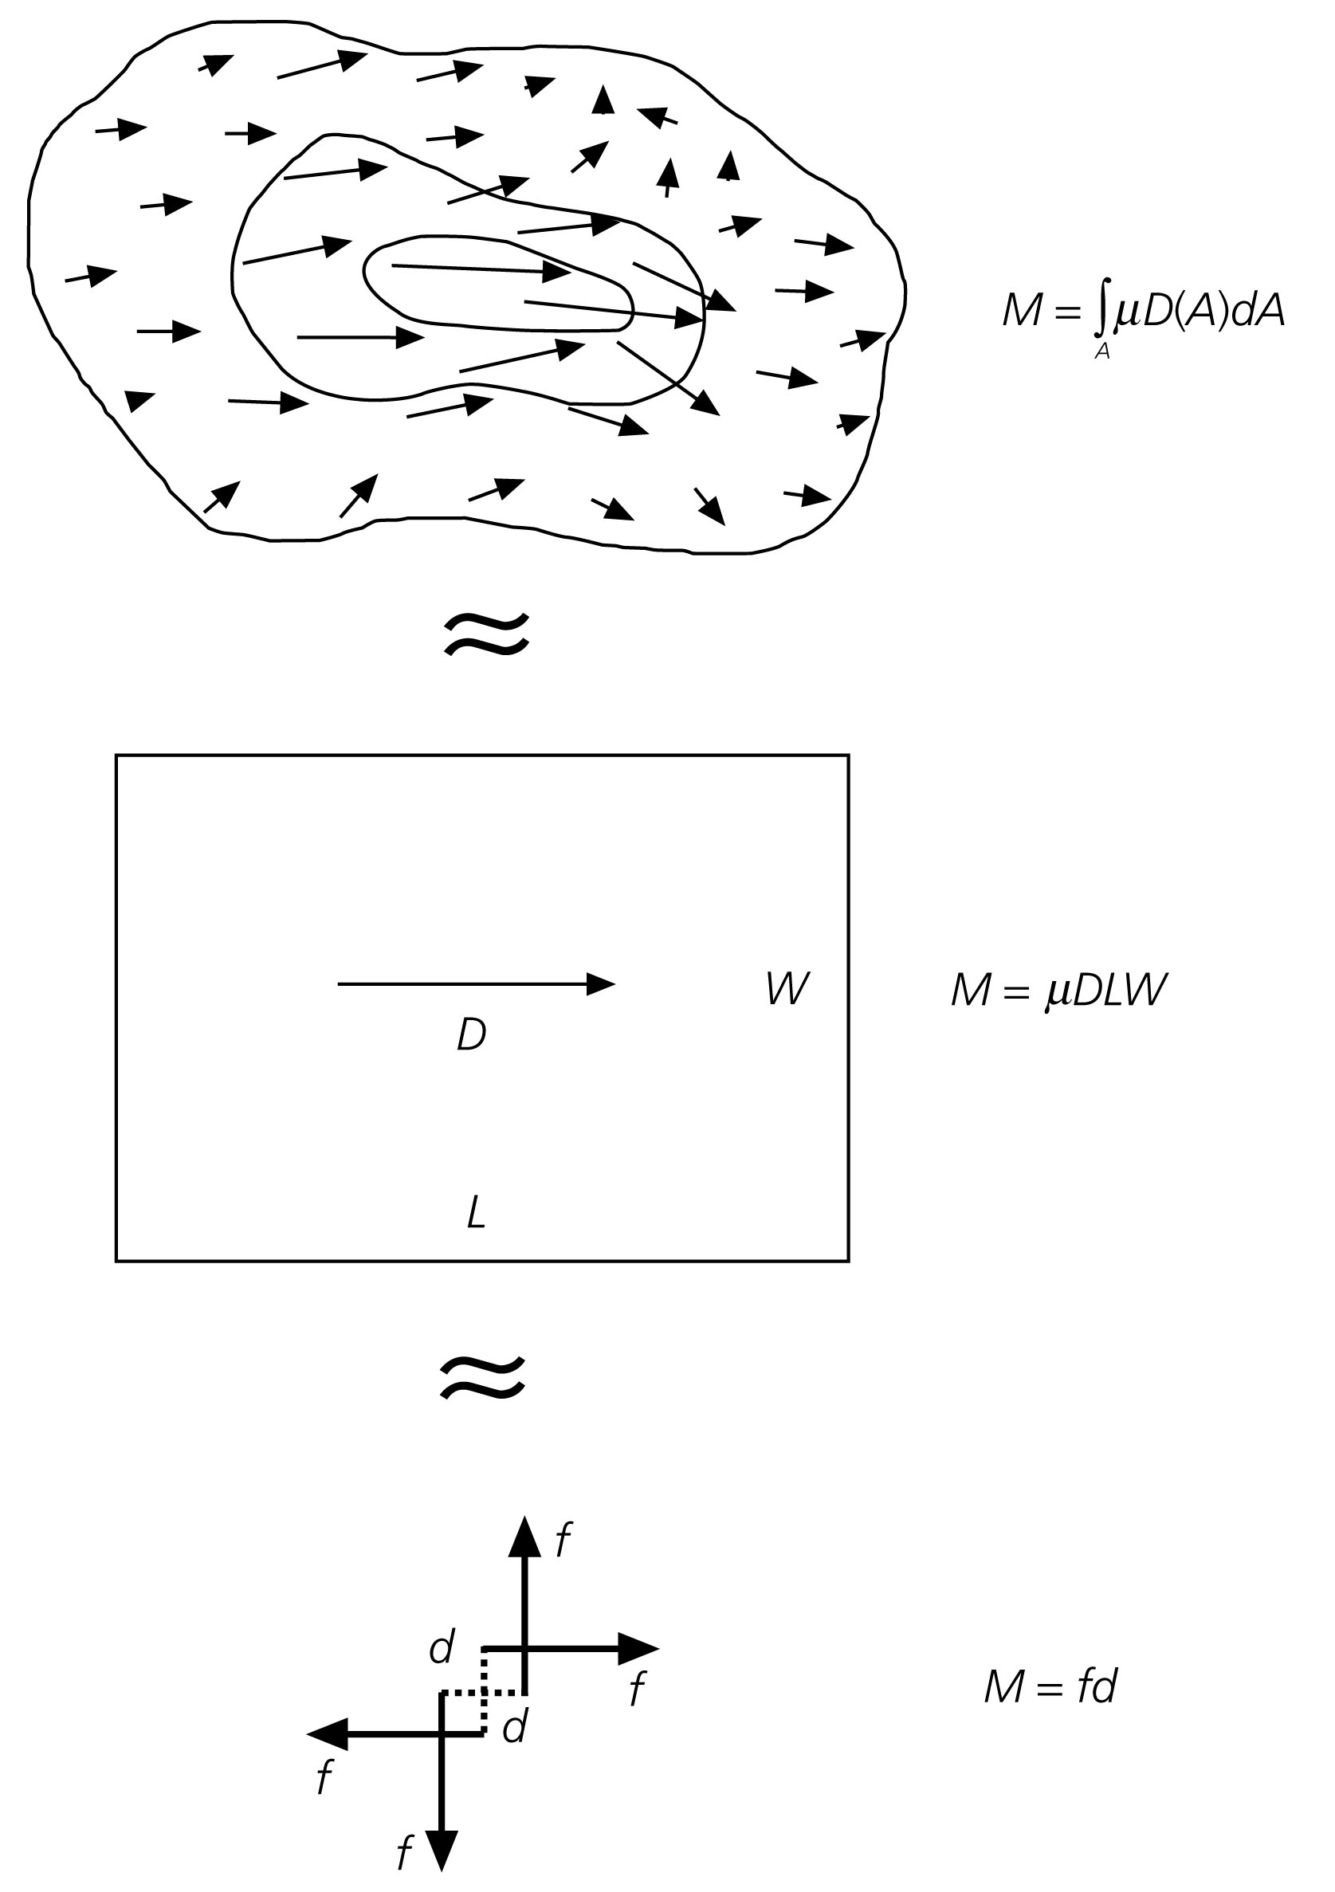
Seismic Moment Tensor: a general mathematical description of fault rupture
It is a point source mathematical model of an earthquake

Slide 24
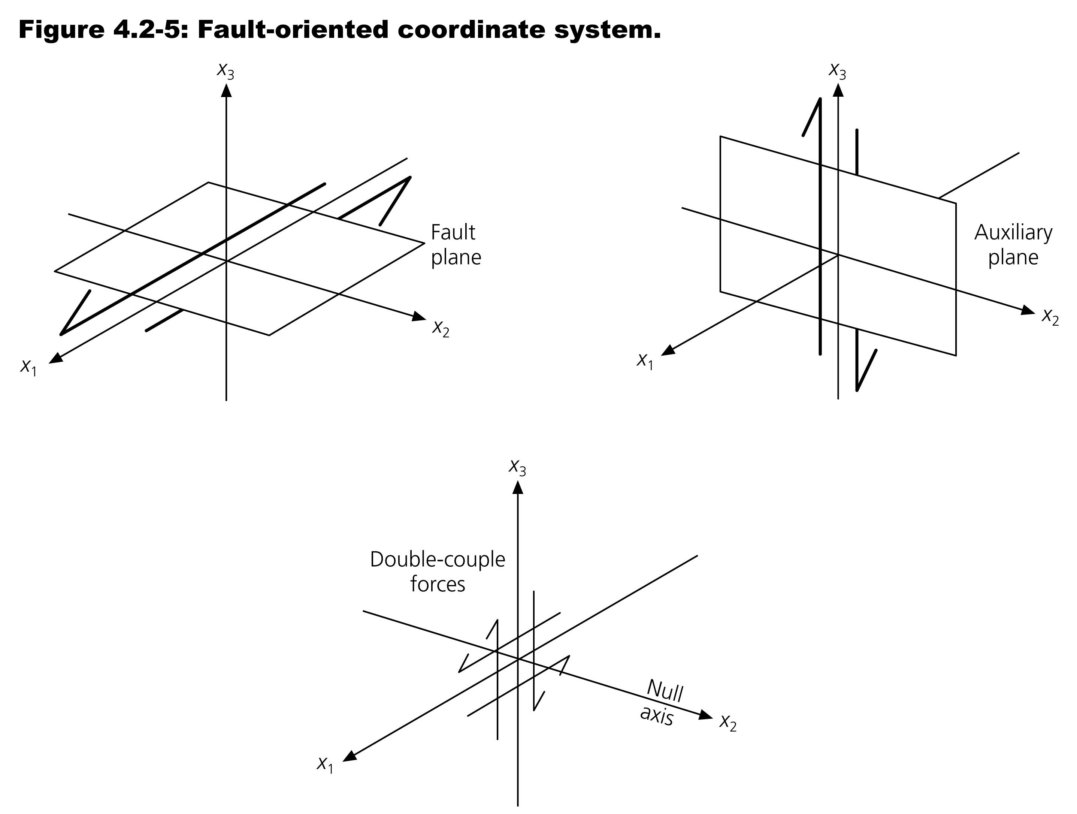
Mathematically, a simple earthquake rupture can be described by a FORCE DOUBLE COUPLE
Pearce, 1977
One couple is oriented in the slip direction with forces on opposite sides of the fault plane.
The other is oriented on opposite sides of the auxiliary plane.

Slide 25
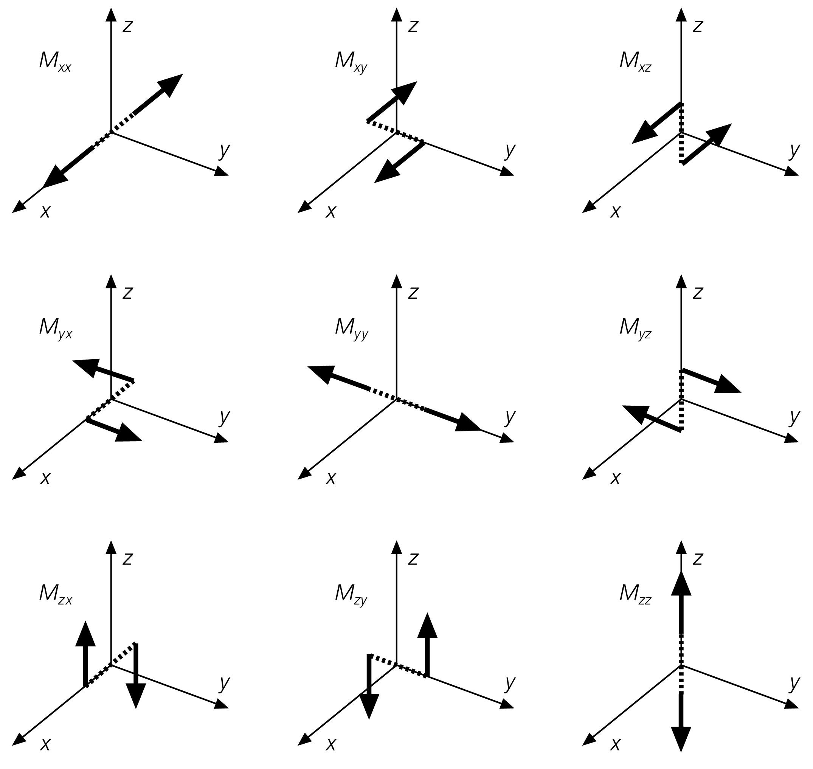
We can generalize the double-couple idea to nine possible force couples.
These make up the components of the seismic moment tensor
The nine force-couple values (“strengths”) can be written into a 3x3 matrix called the Moment Tensor.
[
]
Mxx Mxy Mxz
M = Myx Myy Myz
Mzx Mzy Mzz
The xyz-basis is geographically fixed, combinations of the couples are then used to describe a source of any orientation.

Slide 26
Given the Strike Dip and Rake (or Slip) of a double-couple Earthquake, the Moment Tensor can be determined:
Mxx = −Mo(sinδcosλsin2φ + sin2δsinλsin 2φ)
Mxy = Myx = Mo(sinδcosλcos2φ + sin2δsinλsinφcosφ)
Myy = Mo(sinδcosλsin2φ − sin2δsinλcos2φ)
Mxz = Mzx = −Mo(cosδcosλcosφ + cos2δsinλsinφ)
Myz = Mzy = −Mo(cosδcosλsinφ − cos2δsinλcosφ)
Mzz = Mo(sin2δsinλ)
Φ = strike
δ = dip
λ = rake
Mo = moment
Note: Moment tensors can describe earthquake rupture that is
more complicated than the simple focal mechanism approach

Slide 27
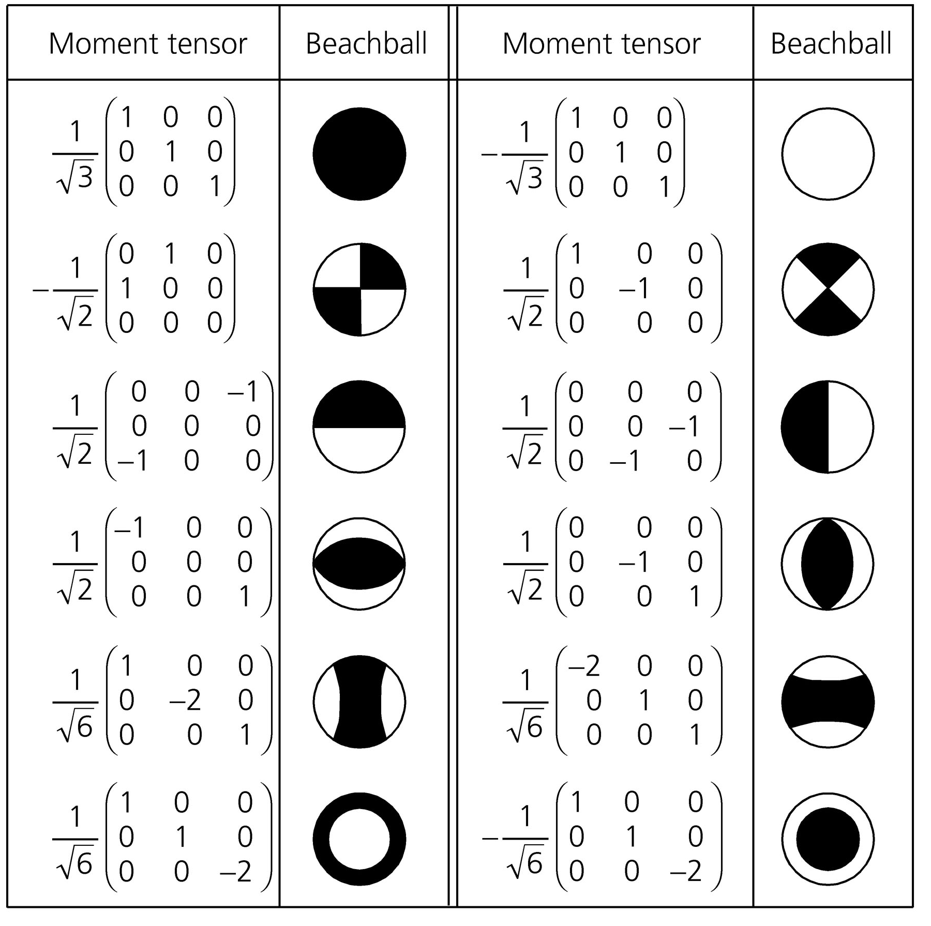

Slide 28
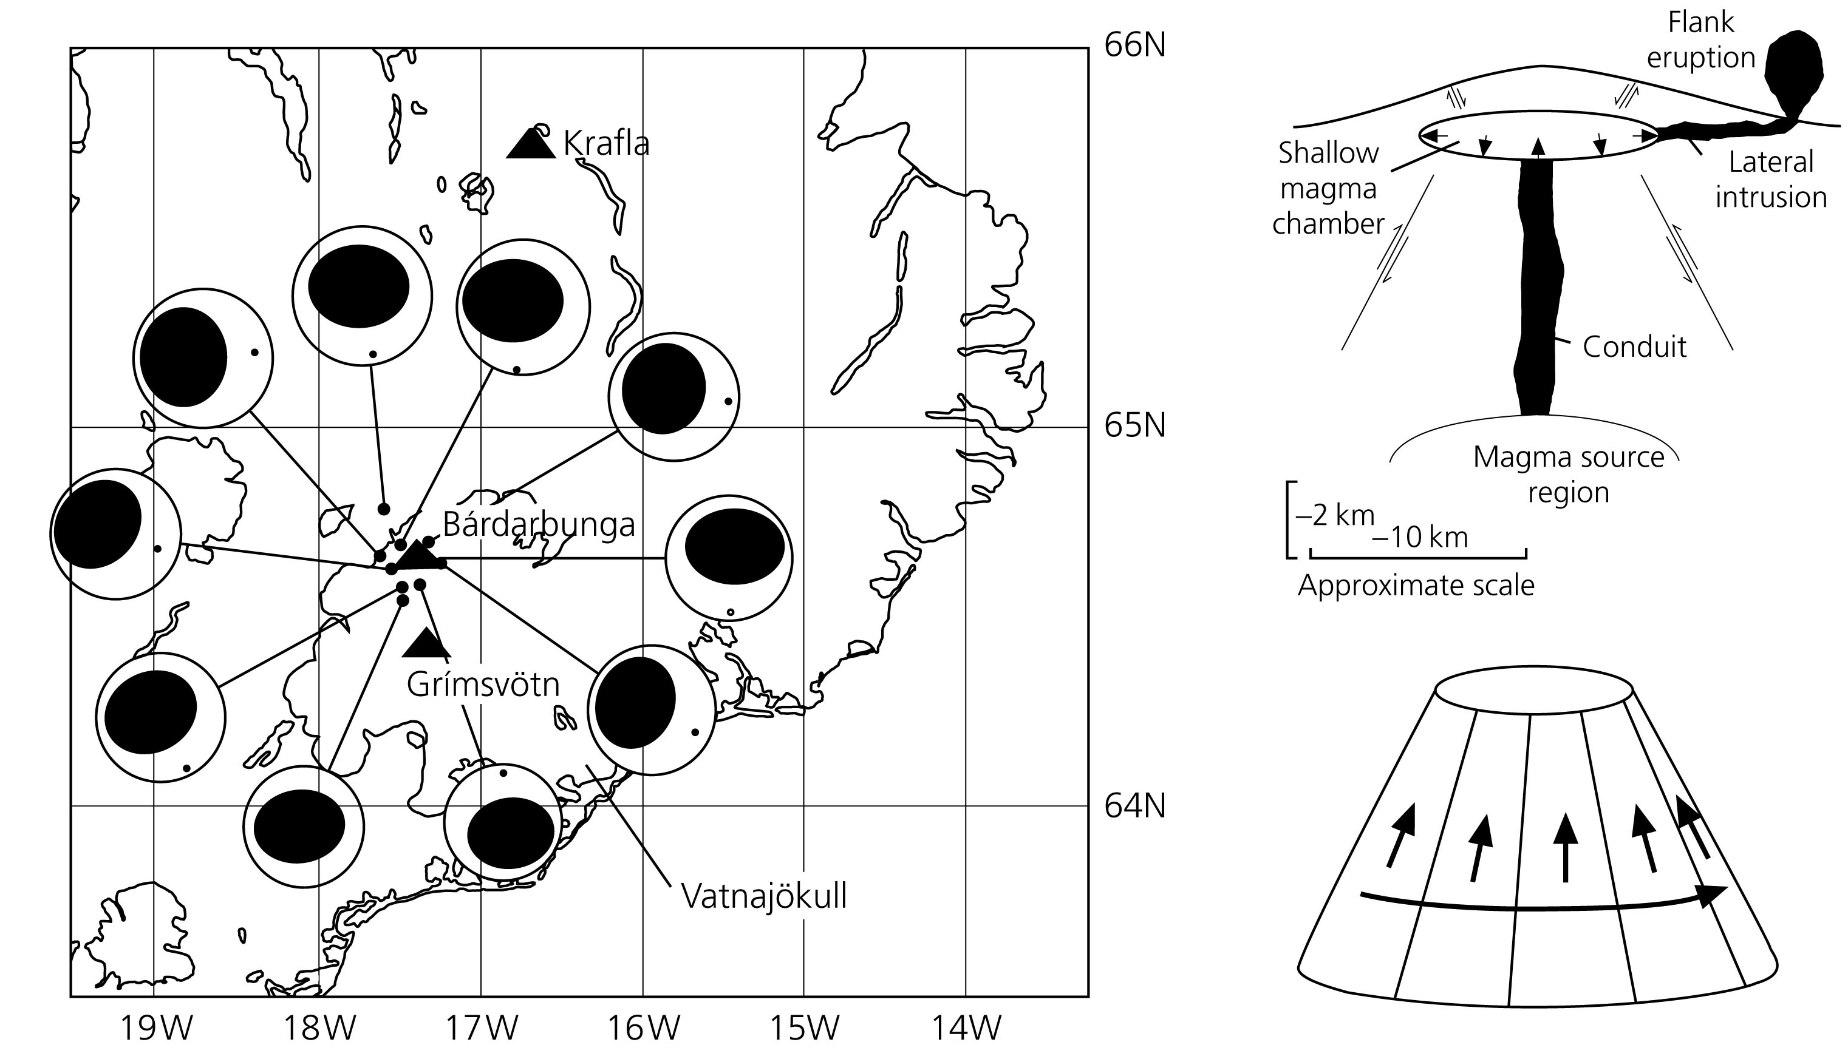
Icelandic Volcano Dynamics
(sub-glacial)
What type of source would give rise to this closely spaced (in time and space) set of focal mechanisms?

Slide 29
Icelandic Volcano Dynamics
(sub-glacial)

Slide 30
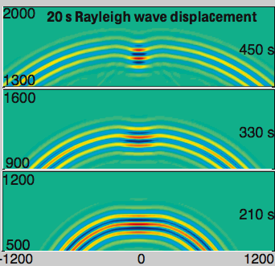
Moment Tensors are used as the source term
in numerical simulations of seismic waves.

Slide 31
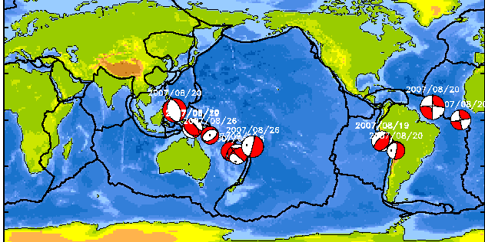
Global Moment Tensor Web Page
http://www.globalcmt.org/
The Global CMT Project involves four main activities:
1.Systematic determination, with a three-to-four-month delay, of moment tensors for earthquakes with M>5 globally, and accumulation of the results in the CMT catalog.
2.Rapid determination of moment tensors for earthquakes with M>5.5 globally and quick dissemination of results ("quick CMTs").
3.Curation of the CMT catalog, which contains more than 25,000 moment tensors for earthquakes since 1976.
4.Development and implementation of improved methods for the quantification of earthquake source characteristics on a global scale.

Slide 32
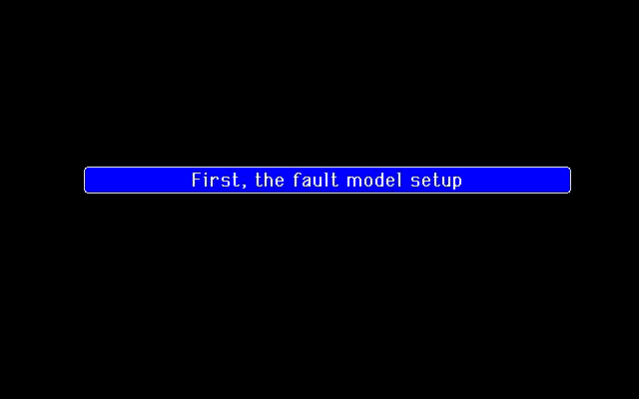
ACTUAL EARTHQUAKE FAULT GEOMETRIES CAN BE MUCH MORE COMPLICATED THAN A RECTANGLE
1992 Landers, California Mw 7.3
SCEC Website

Slide 33
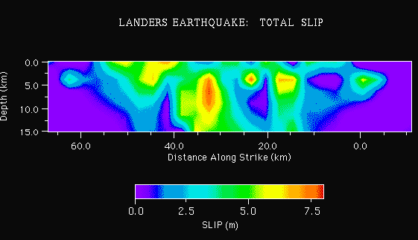
1992 Landers, California Mw 7.3
SCEC Website

Slide 34
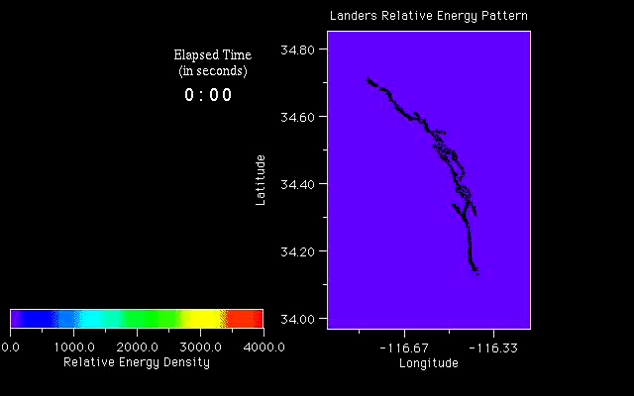
ACTUAL EARTHQUAKE FAULT GEOMETRIES CAN BE MUCH MORE COMPLICATED THAN A RECTANGLE
1992 Landers, California Mw 7.3
SCEC Website

Slide 35
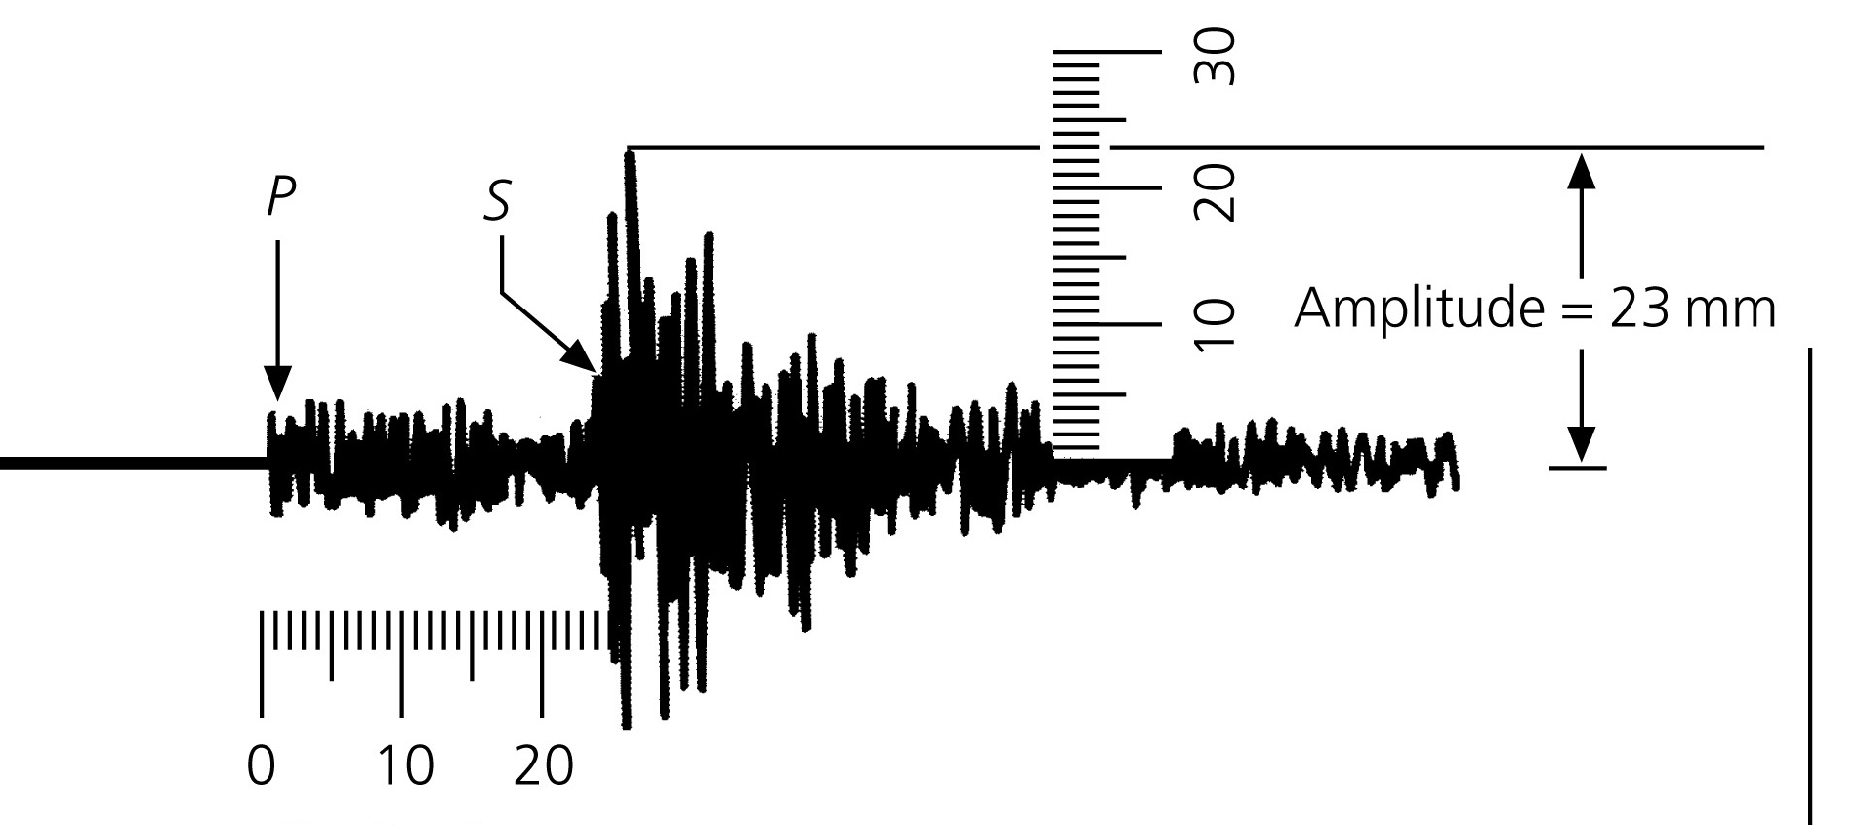
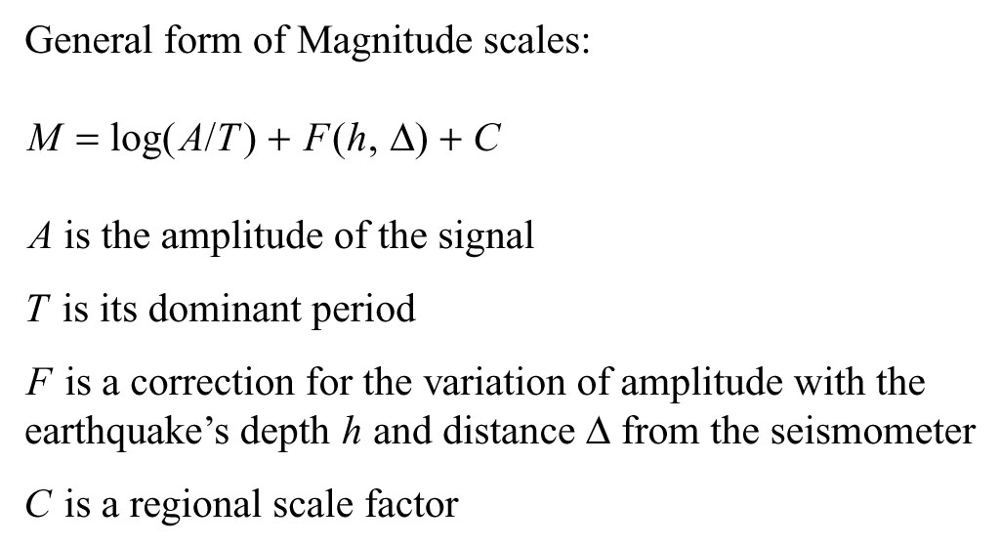
EARTHQUAKE MAGNITUDE
Earliest measures use a dimensionless number measured various ways, including:
M_{L} local (Richter) magnitude
M_{b} body wave magnitude
M_{s} surface wave magnitude
Measured for distant recordings
and
there is NO direct tie to physics of faulting

Slide 36
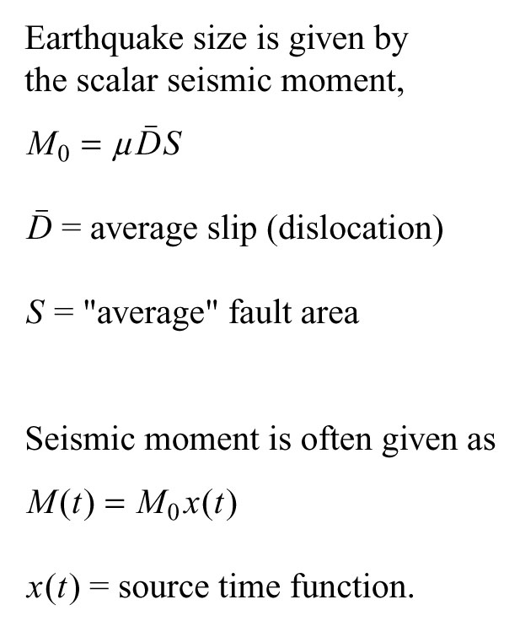
Modern Method:
SEISMIC MOMENT
Gives insight into the amount of slip if we know the fault area from aftershocks, geodesy, or other information.
Based on physics of faulting.
These parameters are determined from waveform analysis of the seismograms produced by an earthquake

Slide 37
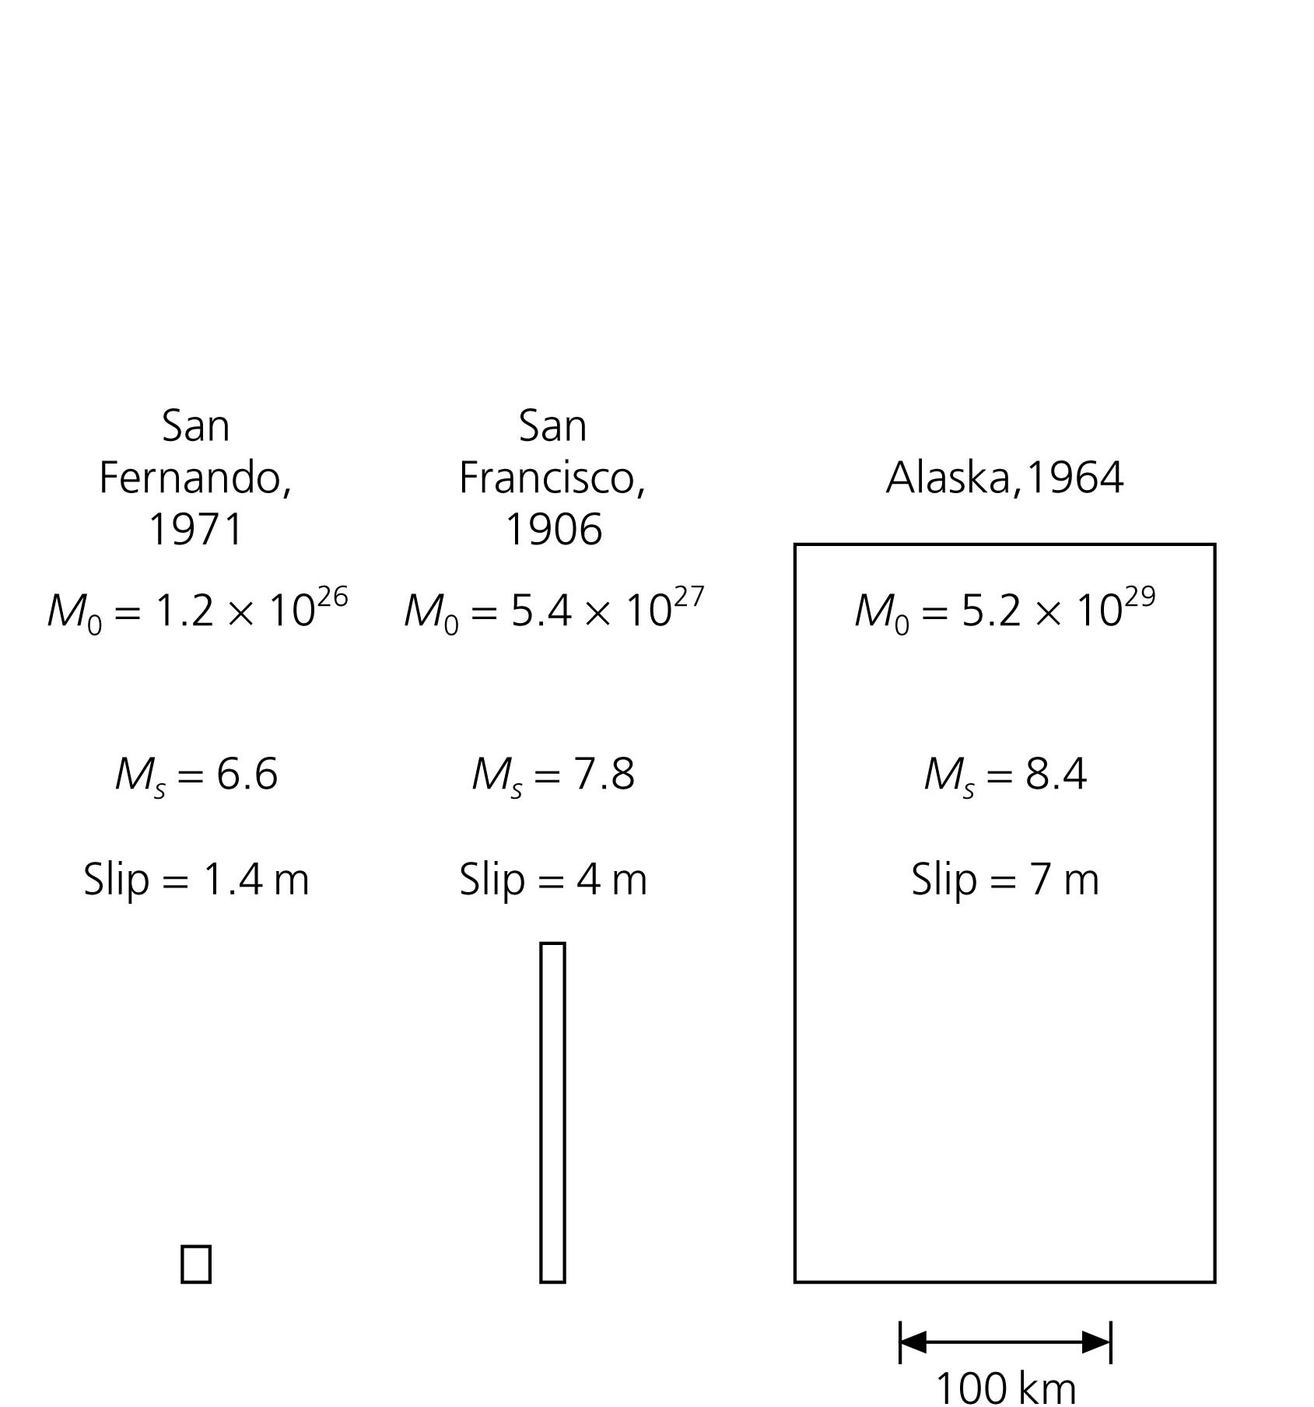
COMPARE EARTHQUAKES USING SEISMIC MOMENT M₀
Magnitudes, moments (dyn-cm), fault areas, and fault slips for several earthquakes
Alaska & San Francisco differ much more than M_{s} implies
M₀ more useful measure
Units: dyne-cm or N-m
A Newton-meter is dimensionally equal to a joule, the SI unit of energy and work. However, it is not appropriate to express a torque in joules - torque and energy are physically different despite being dimensionally equivalent.

Slide 38
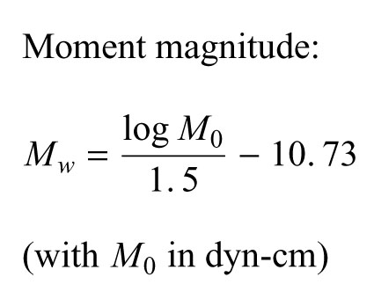
Moment magnitude M_{w}
M_{w} defined from moment and is used to scale the moment so that we can compare moment to the other (more recognizable) scales

Slide 39
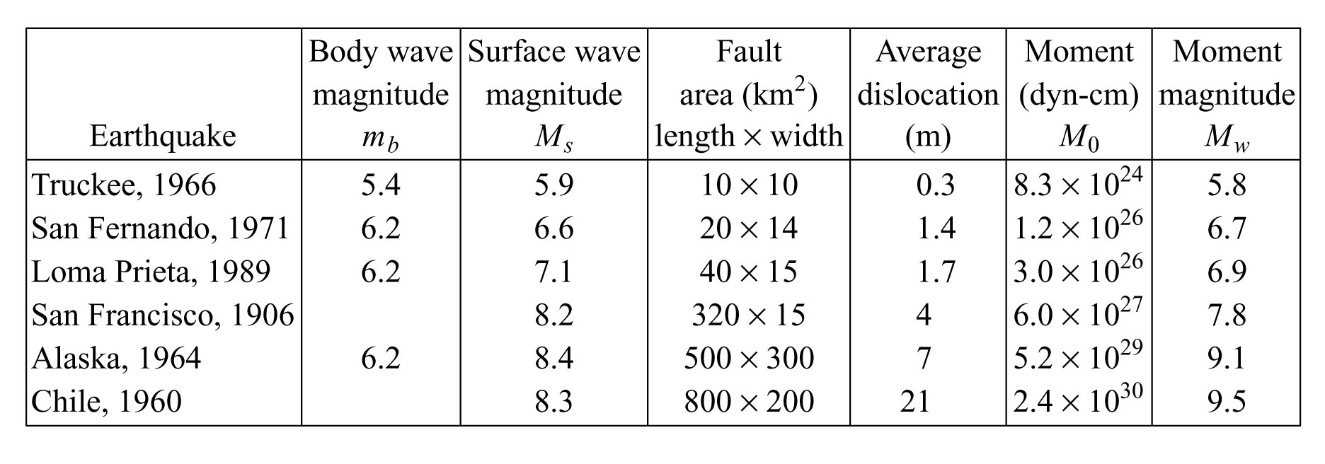
Comparison: Moment magnitude M_{w}
Magnitudes saturate:
No matter how big the earthquake
m_{b} never exceeds ~6.4
M_{s} never exceeds ~8.4
However:
M_{w} is defined from the moment so it never saturates

Slide 40
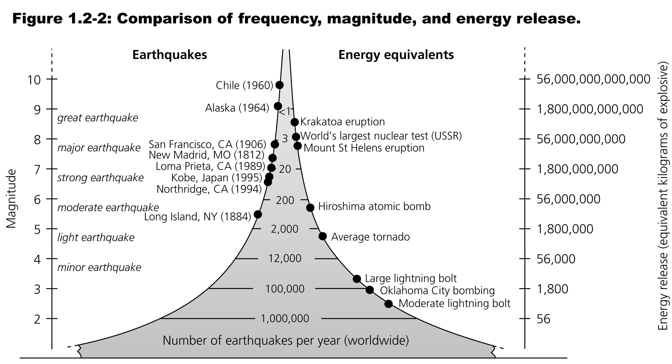
Earthquakes of a given magnitude are ~10 times less frequent than those one magnitude smaller.
An M7 earthquake occurs approximately monthly, and an earthquake of M> 6 about every three days.
Notes:
1906 SF – 4 m of slip on 450-km long fault → 3 x 10**16 Joules of elastic energy – equivalent to a 7 Megaton bomb (Hiroshima was 0.012 Mt)
1960 Chile – 21 m of slip on a 800 km long fault → 10**19 J of elastic energy (more than a 2000 Mt bomb – larger than all nuclear bombs ever exploded – largest was a Soviet atmospheric test of 58 Mt)

